Slide 1
Chapter 13: Inferences about Comparing Two Populations
Instructor: Naveen Abedin

Slide 2
Recap
To conduct hypothesis tests for “difference in two population means”, a t-statistic must be used when population means and variances are all unknown.
There are two types of t-statistics:
Equal-variances t-statistic
Unequal-variances t-statistic
Since population variances are unknown, we have to conduct a “difference in two population variances” hypothesis test to understand whether the population variances are statistically equal or not. Based on the results, we use the appropriate t-statistic to carry out the “difference of means” hypothesis test.

Slide 3
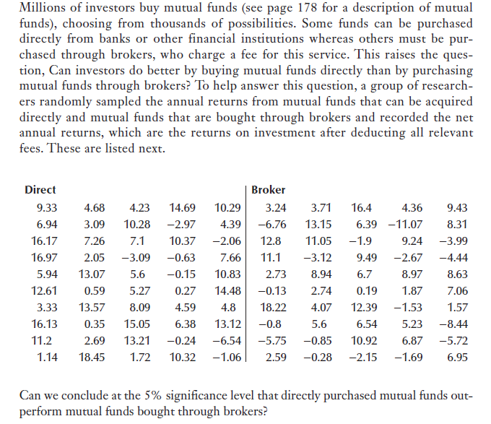

Slide 4
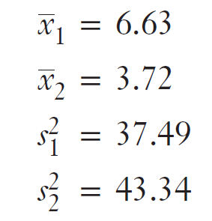
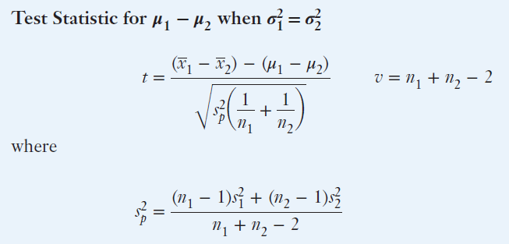
Example 1’s statistics

Slide 5
Example 1: Confidence Interval
Confidence interval estimate in a two population test estimates the difference between the two means. Here, since population 1 is returns from direct purchase and population 2 is returns from broker purchase, this confidence interval is trying to estimate the difference in returns.

Slide 6
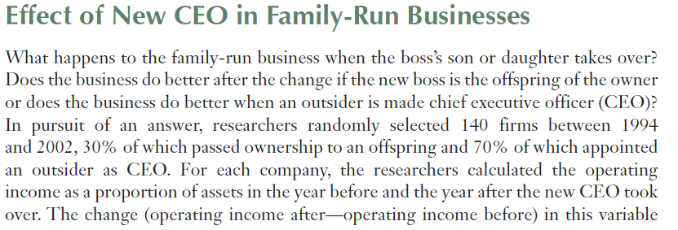
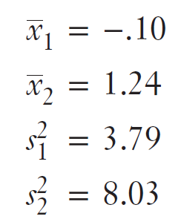

Slide 7
Example 2’s statistics

Slide 8
Some pointers to note
Both the equal-variances test statistic and the unequal variances test statistic requires the population to be normally distributed.

Slide 9
Some pointers to note (cont.)
As seen before, the test statistic to be used for a “difference in population means” test depends on whether or not the population variances are statistically equal or unequal. It is, however, more advantageous to pool sample data under the assumption that the two samples were drawn from populations with a common variance. Combining the samples increases the accuracy of the estimate. This is especially desirable in situations when one or both of the samples are not large enough.
The pooled variance estimator is said to be an exact procedure, meaning the underlying calculations are perfectly accurate if the assumptions are true.
It is consistent with other statistical procedures like ANOVA and regression, meaning is we use pooled variance the conclusions would be exactly the same as any one of these other procedures mentioned.
Be warned: we can get very misleading results if used in the wrong situation.

