Slide 1
Chapter 13: Inferences about Comparing Two Populations Lecture 7a
Instructor: Naveen Abedin

Slide 2
Overview
In a packaging plant, a machine packs cartons with jars. It is supposed that a new machine will pack faster on average than the machine currently installed (old machine). To test that hypothesis a sample of the times it takes each machine to pack ten cartons are recorded. Do the data provide sufficient evidence to conclude that on average the new machine packs faster?

Slide 3
Overview (cont.)
Consider two populations: Population A and Population B.
In this chapter, our goal to find out whether there is sufficient statistical evidence present to suggest that the mean/average parameter is different in the two populations, i.e. we are going to statistically compare two population means.
We will begin by looking at Independent Samples (i.e. sample of A is not related to sample of B). Then we will look at Matched Pair Samples (where sample of A is related to sample of B).
The test statistic depends on whether the variances from the two population are same or different.

Slide 4
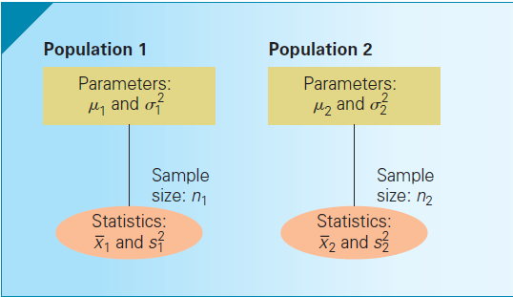
Difference between two means: Independent Samples
Consider two populations from which we randomly draw separate samples. The samples are independent, i.e. the values in one sample reveal no information about the values in the other sample.

Slide 5
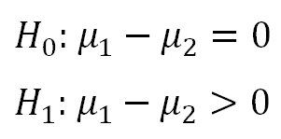
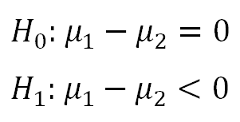
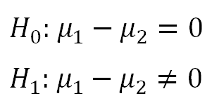
Difference between two means: Independent Samples (cont.)
Using information obtained from the samples, we can test the following hypotheses for “difference of means”:
Right Tail:
Left Tail:
Two Tail:

Slide 6
Difference between two means: Independent Samples (cont.)
Our purpose is to use the sample statistics to test whether there is a statistical difference in the means of the two population.
The parameter of interest is
The best estimator of this parameter is
has a normally distributed sampling distribution if the populations are normal, and approximately normal if the populations are non-normal but the sample sizes are large.

Slide 7
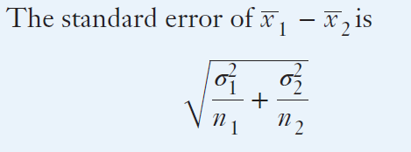
Difference between two means: Independent Samples (cont.)

Slide 8
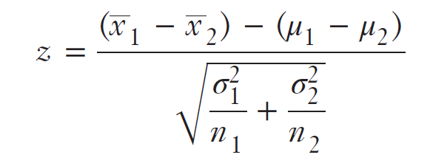
Difference between two means: Independent Samples (cont.)
If the population variances are known, then a hypothesis test for difference of means can be conducted using the test statistic:
Interval Estimate can be computed as:

Slide 9
Difference between two means: Independent Samples (cont.)
However, the z statistic is rarely used because in most real world cases the population variances are unknown.

Slide 10
Difference between two means: Independent Samples (cont.)
When population variances are unknown, the best estimators for these are sample variances.
When population variances are unknown, then the sampling distribution to conduct the hypotheses tests are Student t Distributed.
The test statistic, t, depends on whether the variances of the two populations are equal or unequal.

Slide 11
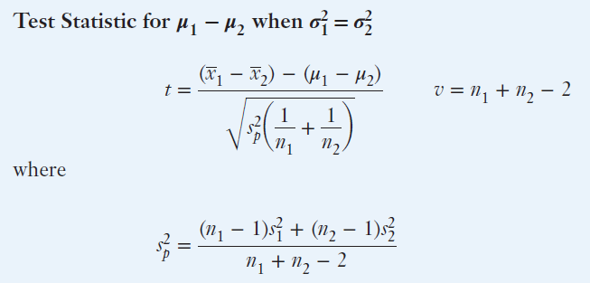
Difference between two means: Independent Samples (cont.)
is known as the pooled variance estimator.

Slide 12
Difference between two means: Independent Samples (cont.)
The pooled variance estimator is the weighted average of two sample variances, where the number of degrees of freedom in each sample is used as weights.
The requirement for using this method is that the population variances are equal
The test statistic is Student t distributed with degrees of freedom . The statistic is called equal-variances test statistic.

Slide 13
Difference between two means: Independent Samples (cont.)
The interval estimator for equal variances case is:

Slide 14
Difference between two means: Independent Samples (cont.)

Slide 15
Difference between two means: Independent Samples (cont.)
Therefore, the test statistic for the difference of means test depends on whether the population variances are statistically equal or not.
However, we do not have any knowledge on what the values of population variances are, thus we cannot readily observe if the variances are equal or unequal. To resolve this issue, we have to carry out a difference in population variances hypothesis test.
If the test indicates that there is enough statistical evidence present to infer that the variances equal, then we have to use the pooled variance estimator to compute the equal-variances test statistic. If the test indicates that the evidence points towards unequal population variances, then we have to use the unequal-variances test statistic.

Slide 16
Difference between two means: Independent Samples (cont.)
Since population variances are unknown, sample variances have to be used to conduct a hypothesis test to see if there is sufficient statistical evidence to infer the population variances are different.
The Hypothesis Test for difference in population variances uses a test statistic that follows the F-distribution.

Slide 17
Steps for carrying out Hypothesis Test for Difference in Population Means: Independent Sample

Slide 18
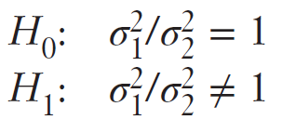
Hypothesis Test for Difference in Population Variances
The test statistic follows the F-distribution:
Rejection Region:

Slide 19
Example 1
A dataset contains 282 ceramic strength measurements for two batches of material.
Batch 1
Number of obs: 141
Sample mean: 688.99
Sample standard deviation: 65.55
Batch 2
Number of observations: 141
Sample mean: 611.16
Sample standard deviation: 61.85
Test for equality of variance in the two populations at 5% significance level.

