Slide 1
Chapter 11: Introduction to Hypothesis Testing Lecture 5a
Instructor: Naveen Abedin

Slide 2
Introduction
The second procedure for making statistical inferences is hypothesis testing. Here, our purpose is to determine whether enough statistical evidence exists to enable us to conclude that a belief/hypothesis/theory about a parameter is supported by the data.

Slide 3
Introduction (cont.)
There are two components of hypothesis testing:-
Null Hypothesis: H0
Alternative Hypothesis: H1
Suppose a man has been accused of committing murder, and is now standing in trial. The null hypothesis represents the hypothesis that he is innocent, while the alternative hypothesis represents the hypothesis that he is guilty.

Slide 4
Introduction (cont.)
If the jury finds enough evidence to send him to jail, then in statistical terms it is said that “we are rejecting the null hypothesis in favor of the alternative hypothesis”
If there is not enough evidence to find the suspect guilty, then it means we are “not rejecting the null hypothesis in favor of the alternative one”
Be careful : “not rejecting the null hypothesis” is not the same as “accepting the null hypothesis”.

Slide 5
Errors in Hypothesis Testing
There are two possible errors concerning hypothesis testing:
Type I Error: This occurs when we reject the true null hypothesis. e.g. an innocent person is wrongly charged with crime. Probability of Type I error is denoted by the symbol α, which is called the significance level.
Type II Error: This occurs when we do not reject a false null hypothesis. e.g. when a guilty person is set free. The probability of Type II error is denoted by the symbol, β.
The error probabilities, α and β, are inversely related, meaning that an attempt to reduce one will increase the other.

Slide 6
Example 1
Can the environment of the examination room have an effect on the ability of students to perform? This was the question posed by the Psychology Department of the University. There are many factors involved here, but one lecturer has an interest in scents and put forward the theory that a pleasant floral scent in the room would improve the score on an exam.
The experiment was conducted on a random sample of students. It was found that with the presence of a floral scent, the average test score was 66. Normally, the mean score was 64. Does the floral scent really improve the performance of students on an exam?

Slide 7
Example 1 (cont.)
The answer to this question can be posed as a hypothesis test – i.e. we are hypothesizing that floral scents improve exam performances. To see whether is this argument is valid or not, we can form a hypothesis test:
The Null Hypothesis is always written as if nothing has changed and so is always written as “equal to” the regular observation.
Null Hypothesis : μ = 64
The Alternative Hypothesis is written as if things are changing according to the hypothesized manner. It represents what we are trying to investigate.
Alternative Hypothesis: μ > 64

Slide 8
Example 1 (cont.)
Type I Error: Type I error occurs when we reject a true null hypothesis, e.g. we come to the conclusion that floral scents improve exam performance, when in fact it actually does not.
Type II Error: In this example Type II Error would occur if we do not reject a false null hypothesis – i.e. we do not reject the notion that average performance is not improved by the scent, when in fact the scent actually does improve performance.

Slide 9
Structure of Hypothesis Testing
Two Hypotheses:-
Null Hypothesis
Alternative Hypothesis
Testing procedure begins with the assumption that the null hypothesis is true.
The goal is to determine whether there is enough evidence to infer (decide) that the alternative hypothesis is true.

Slide 10
Structure of Hypothesis Testing (cont.)
Two possible outcomes:-
Conclude that there is enough evidence to support the alternative hypothesis
Conclude that there is not enough evidence to support the alternative hypothesis
Two possible errors can be made:-
Type I Error: Rejecting a true null hypothesis P(Type I Error) = α
Type II Error: Not Rejecting a false null hypothesis; P(Type II Error) = β

Slide 11
Example 2: Two-tail test
Suppose an operations manager has observed for the past 10 years that mean demand is 350. New policy reforms are to be implemented so the manager wants to know if the demand now is different from 350.
Present this problem in the form of a hypothesis test:
Null Hypothesis: H0: μ = 350
Alternative Hypothesis: H1: μ ≠ 350

Slide 12
Example 2 (cont.): Right tail test
Suppose an operations manager has observed for the past 10 years that mean demand is 350. However, the company has now launched several advertising campaigns, hence, manager suspects that demand must have now increased. The manager has set up this concern in the form of a hypothesis test:
Null Hypothesis: H0: μ = 350
Alternative Hypothesis: H1: μ > 350
Note: the null hypothesis will always state that the parameter is equal (=) to a specified value.

Slide 13
Example 2 (cont.): Left tail test
Suppose an operations manager has observed for the past 10 years that mean demand is 350. Due to a recent recession in the economy, the manager is concerned that overall demand for his product has decreased. In order to test this, the manager has set up the following hypothesis:
Null Hypothesis: H0: μ = 350
Alternative Hypothesis: H1: μ < 350

Slide 14
Sample Statistic in Hypothesis Testing
Population data is extremely difficult to obtain, so testing for a parameter directly is not feasible. Instead we select a random sample that we can use to test a parameter.
When testing for population mean, we draw a random sample and apply the information from the sample mean to conduct hypothesis tests. Recall, sample mean is the best estimator of population mean.
If the test statistic is significantly inconsistent with the null hypothesis, then we reject the null hypothesis and infer that the alternative is true.

Slide 15
Example 3
A department store’s mean monthly account of credit customers is $170. The manager of the department store is thinking about establishing a new billing system. After a thorough financial analysis, she determines the system will be cost-effective is mean monthly account exceeds $170. A random sample of 400 accounts was drawn after installing the system, and the average was $178. The manager knows that the accounts are normally distributed with a population standard deviation of $65. Can the manager conclude from this that the new billing system is cost-effective?

Slide 16
Method I: Rejection Region
Rejection Region: The is a range of values such that is the test statistic falls into that range, we decide to reject the null hypothesis in favor of the alternative hypothesis.
A threshold is set for the rejection region such that if the sample mean is greater than equal to the threshold value, the null hypothesis is rejected in favor of the alternative hypothesis.
Rejection Region:

Slide 17
Method I: Rejection Region (cont.)
The rejection region is related to Type I error.
Recall that Type I Error is rejecting the true null hypothesis, and the probability of committing Type I Error is α.

Slide 18
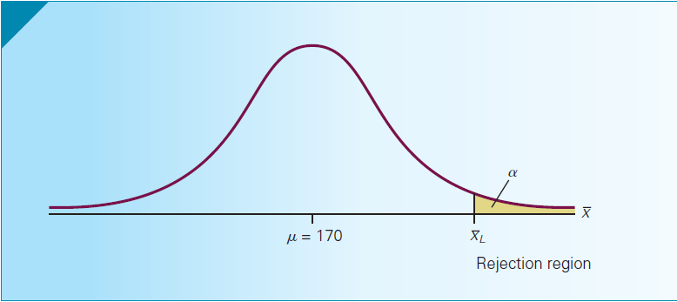
Method I: Rejection Region (cont.)

Slide 19
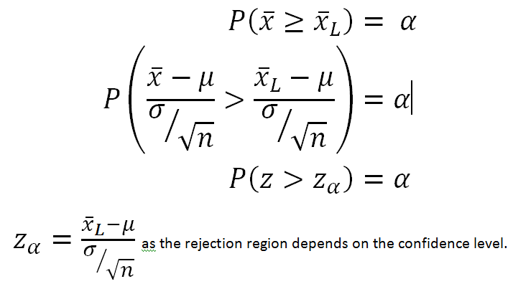
Method I: Rejection Region (cont.)
The rejection range probability converted to standard form:

Slide 20
Method I: Rejection Region (cont.)
It is in our interest to minimize Type I Error - we do not want to wrongfully reject a true null hypothesis and install the expensive billing system although it is not cost-effective.
Reducing Type I error is reducing the significance level. If significance level is reduced, the Z statistic gets larger.

