Slide 1
ECO 173 Chapter 10: Introduction to Estimation Lecture 5a
Instructor: Naveen Abedin

Slide 2
Recap
Statistical inference is the process by which we acquire information and draw conclusions about populations from samples.
There are two general procedures for making inferences about populations from samples:
Estimation
Hypothesis Testing

Slide 3
Concept of Estimation
The objective of estimation is to determine the approximate value of a population parameter on the basis of a sample statistic. e.g. sample mean is employed to estimate population mean, thus sample mean is the estimator or estimate.
There are two types of estimations:
Point Estimator
Interval Estimator

Slide 4
Point Estimator
Consider Population A which is infinitely large. A random sample is extracted from Population A, and the sample mean is computed. If we consider the value of sample mean (estimator) as an estimate of the population mean, then the sample mean is called a point estimator.
A point estimator draws inferences about a population by estimating the value of an unknown parameter using a single value or point, (i.e. there is no repeated sampling involved, hence no sampling distribution analyzed)

Slide 5
Point Estimator (cont.)
There are three drawbacks to using point estimators:-
We can be practically certain that the estimate will be wrong – the probability that a continuous random variable will equal a specific value is 0 (recall from the previous chapter that sample mean has a continuous probability distribution called a sampling distribution)
We cannot be certain of how close the estimator is to the parameter
In drawing inferences about a population, it is intuitively reasonable to expect that a large sample will produce more accurate results because it contains more information than a smaller sample does. Point estimators do not have the capacity to reflect the effects of larger sample sizes.

Slide 6
Interval Estimator
An interval estimator draws inferences about a population by estimating the value of an unknown parameter using an interval. Interval estimator takes into account the sample size.
A simple example to illustrate the difference between point and interval estimate: A teacher wants to calculate the mean summer income of his second-year business students. He selects 25 students at random, which has a sample mean of $400 (point estimate). If the teacher uses interval estimate, the mean income may lie between $380 an $420.

Slide 7
Unbiased Estimator
The desirable quality of an estimator is unbiased-ness. A unbiased estimator of a population parameter is an estimator whose expected value is equal to the parameter.
Sample mean is an unbiased estimator of the population mean μ, if:
Notes:
This means if you draw a large (millions) number of samples and calculate the sample mean of each sample, then the average value of the sample mean will equal to the parameter.

Slide 8
Consistency
The estimator being unbiased simply assures us that the expected value equals the parameter. It does not however tell us how close the estimator is to the parameter. However, as the sample size grows larger, the sample statistic should get closer to the population parameter. This quality is known as consistency.
An unbiased estimator is said to be consistent if the difference between estimator and the parameter grows smaller as the sample size grows larger. This is because with increased sample size the variance gets smaller and the distribution becomes narrower around the population mean.

Slide 9
Relative Efficiency
If there are two unbiased estimators of a parameter, then the one with a smaller variance is said to have relative efficiency compared to the other one.

Slide 10
Interval Estimation: when σ is known
Consider the normally distributed Population B that has a mean of μ and a standard deviation of σ. The population mean is assumed to be unknown.
The interval estimation for the population parameter μ is:-
(1 – α) represents the confidence level – it is an indicator of the degree of assurance that the interval will contain the true population mean.

Slide 11
Interval Estimation: when σ is known (cont.)

Slide 12
Interval Estimation: when σ is known (cont.)
The confidence level is the probability that the interval includes the actual value μ. Therefore, we generally set 1 – α close to 1, (like 0.9, 0.95 or 0.99).
Suppose 1 – α =0.95. This means α = 0.05 and α/2 = 0.025.
The resulting confidence interval estimator is called the 95% confidence interval estimator of μ.

Slide 13
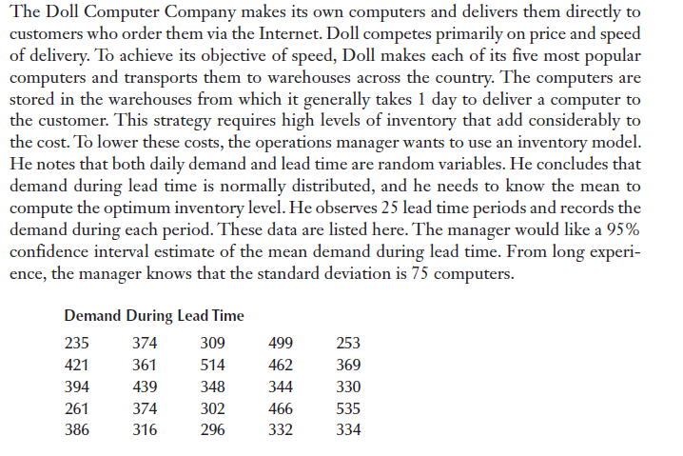
Example 1

Slide 14
Example 1 (Answer)
Interpretation: With a 95% probability, the interval 340.76 to 399.56 will include the true population mean.

Slide 15
Disadvantages of a wide interval
A wide confidence interval is more likely to capture the true population parameter, but the ultimate result becomes vague.
For instance: a 95% confidence interval shows us that the starting salary of an accountant lies between $15,000 and $100,000. The interval is so wide, that it barely gives us any useful information. On the other hand, if the interval estimate is $52,000 to $55,000, then this gives us more precise information.

Slide 16
Width of Confidence Interval
The width of the confidence interval estimate is a function of population standard deviation, confidence level and sample size.
Doubling the standard deviation has the effect of doubling the width of the confidence interval estimate.
Decreasing the confidence level narrows the interval and increasing it widens the interval.
Increasing the sample size by four folds decreases the width of the interval by half.

Slide 17
Selecting Sample Size
A wide confidence interval is undesirable as it provides too little information. Hence the desired interval width can be set if we select the appropriate sample size.
Error of Estimation: Sampling error is the difference between the sample and the population that exists only because of the observations that happened to be selected from the sample. Thus sampling error is the difference between the estimator and the parameter. This difference is called the error of estimation.

Slide 18
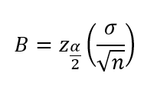
Selecting Sample Size (cont.)
This means that the maximum error of estimation we are willing to tolerate is:
The bound on the error of estimation can be called:
From B, we can solve for the sample size, n

Slide 19
Example 3
The manager of Doll Computer Company has decided that he needed to estimate the mean demand during lead time within 16 units, which is the bound error of estimation. What sample size must be chosen to ensure this?

