Slide 1
ECO173: Applied Statistics II Introductory Concepts & Random Variables
Lecture 1
Instructor: Naveen Abedin

Slide 2
Definitions
Populations: the group of all items of interest, e.g. all currently enrolled students of North South University; population of Bangladesh
Sample: A sample is a set of data drawn from the studied population, e.g. a sample of 500 students are drawn from the population of all enrolled students in NSU; a sample of 150000 people are drawn from the population of 156,000,000 people in Bangladesh (2010 stats).

Slide 3
Definitions (cont.)
The descriptive measure of a population is called a parameter, e.g. average number of soft drinks consumed per day by all students enrolled in NSU.
The descriptive measure of a sample is called a statistic, e.g. average number of soft drinks consumed per day by the sample of students enrolled in NSU

Slide 4
Definitions (cont.)
Statistical Inference: The process of making an estimate, prediction or decision about a population based on sample data. Most of the time populations are extremely large, and trying to obtain information on each individual member is both impractical and expensive. Hence, samples are drawn from the population to make estimations about the population.

Slide 5
Definitions (cont.)
Variable: some characteristic of a population or sample that we are interested to measure and study, e.g. income, age, grade, preference
Values: The possible observations of a variable, i.e. the values a variable of interest can take, e.g. semester grade score can be any value between 0 to 100. Sometimes, variables can only take integer values, or coded values (e.g. yes or no; single or married; male or female)

Slide 6
Random Variables
Experiment with two flipped coins

Slide 7
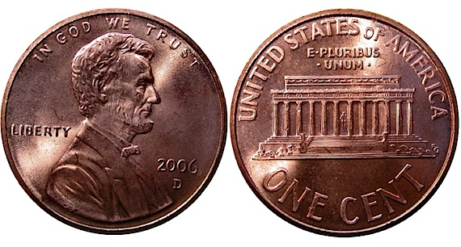
Random Variable (cont.)
Remember, that each coin has two sides – a head and a tail:

Slide 8
Random Variable (cont.)
The possible outcomes that can arise are in the table. Let us define a variable X that registers the number of heads obtained from the dual toss:
Coin 1 | Coin 2 | Total Number of Heads (X)
H | H | 2
H | T | 1
T | H | 1
T | T | 0

Slide 9
Random Variable (cont.)
The number of heads arising from the dual coin toss can be regarded as a random variable, X, where the possible values that X can take are 0, 1 and 2.
By definition, a random variable is a function or rule that assigns a number to each outcome of an experiment.

Slide 10
Random Variable (cont.)
Consider two fair dice of six sides each being tossed together:

Slide 11
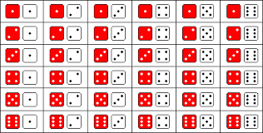
Random Variable (cont.)
The possible outcomes from this dual dice toss can be seen in the picture:

Slide 12
Random Variable (cont.)
In numerical form, the results can be displayed as such:

Slide 13
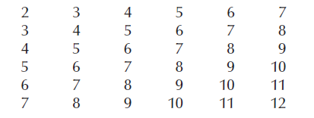
Random Variable (cont.)
The addition of numbers obtained from the dual dice toss are given as follows:

Slide 14
Random Variable (cont.)
Let Y be the random variable representing the total number of points obtained from a dual dice throw.
In this case, the possible values that Y can attain are: 2, 3, 4, 5, 6, 7, 8, 9, 10, 11 and 12.

Slide 15
Random Variable (cont.)
There are two types of random variables:
Discrete Random Variable: a random variable that can only take countable numbers, e.g. the number of vehicles parked in a parking lot that has a capacity to hold 100 vehicles.
Continuous Random Variable: a random variable whose values are uncountable. E.g. the amount of time it takes to complete a 1 hr statistics exam can be any number between 0 mins to 60 mins. Someone might finish it in 47.0256 mins, another person might finish in 7.33333 mins.

