Slide 1
SUPPLY AND DEMAND THEORY (Part 2)

Slide 2
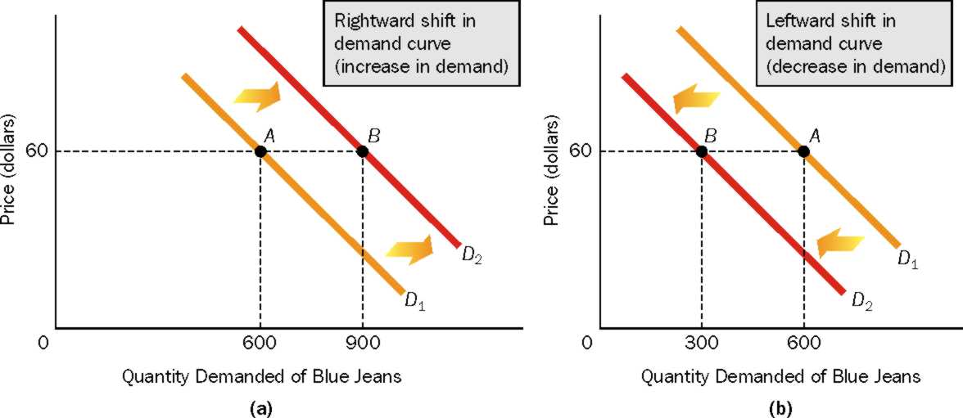
Shifts in the Demand Curve

Slide 3
What Factors Cause the Demand Curve to Shift?
Income
Preferences
Prices of Related Goods
Number of Buyers
Expectations of Future Prices
Lets look at how each affect demand…

Slide 4
What Factors Cause the Demand Curve to Shift? (CONT)
INCOME: As a person’s income changes (increases or decreases), his or her demand for a particular good may rise, fall or remain constant.
Normal Good: A good the demand for which rises (falls), as income rises (falls). Example?
Inferior Good: A good the demand for which falls (rises), as income rises (falls). Example?
Neutral Good: A good the demand for does not change as income rises or falls. Example?

Slide 5
What Factors Cause the Demand Curve to Shift? (CONT)
PREFERENCES: People’s preferences affect the amount of a good they are willing to buy at a particular price
A change in preference AWAY from a good (example: NORMAL JEANS) ➔ Demand Fall ➔ Demand shifts LEFT
A change in preference IN FAVOUR of a good (example: TORN JEANS) ➔ Demand Rises ➔ Demand shifts RIGHT.

Slide 6
What Factors Cause the Demand Curve to Shift? (CONT)
PRICES OF RELATED GOODS: There are two types.
Substitutes: Two goods that satisfy similar needs or desires. If two goods are substitutes, the demand for one good rises as the price of the other good rises (or the demand for one good falls as the price of the other good falls). Example?
Complements: Two goods that are used jointly in consumption. If two goods are complements, the demand for one rises as the price of the other falls, (or, the demand for one falls as the price of the other rises). Example?

Slide 7
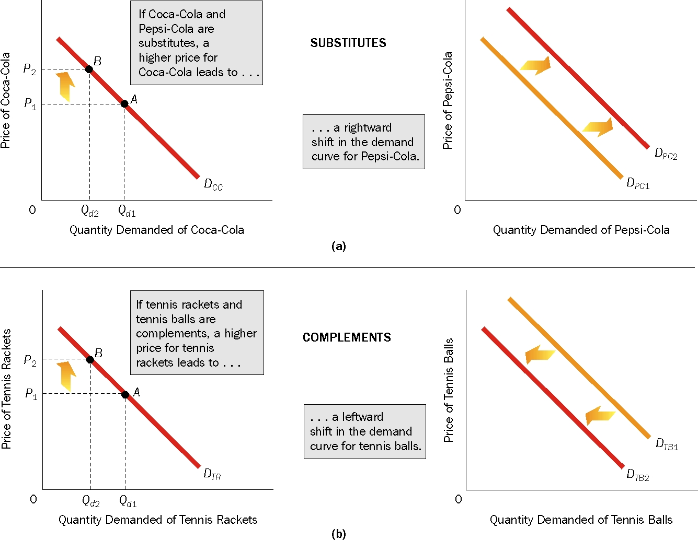
What Factors Cause the Demand Curve to Shift? (CONT)

Slide 8
What Factors Cause the Demand Curve to Shift? (CONT)
NUMBER OF BUYERS:
The demand for a good in a particular market area is related to the number of buyers in the area.
Buyers ➔ Demand ➔ Demand Shifts right
Can be caused by:
Higher Birth rate
Increased immigration
Migration in the region
Buyers ➔ Demand ➔ Demand Shifts left
Can be caused by:
Higher Death rate
Migration out of the region

Slide 9
What Factors Cause the Demand Curve to Shift? (CONT)
EXPECTATIONS OF FUTURE PRICES:
Expect prices ➔ Current Consumption ➔ Demand Shifts RIGHT.
Example? Houses, iPhones?
Expect prices ➔ Current Consumption ➔ Demand Shifts LEFT.
Example?

Slide 10
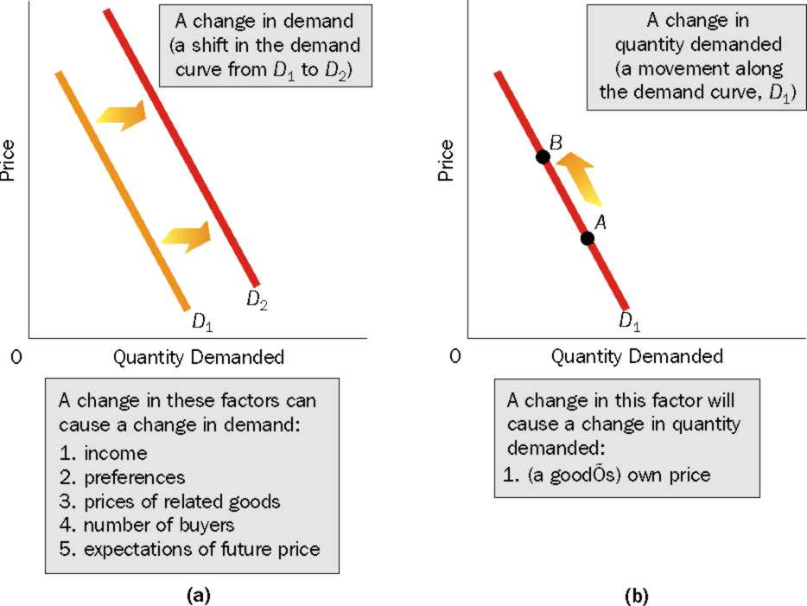
SUMMARIZING….

Slide 11
SUPPLY

Slide 12
SUPPLY
SUPPLY:
The willingness and ability of sellers to produce and offer to sell different quantities of a good at different prices during a specific time period.
LAW OF SUPPLY:
As the price of a good rises, the quantity supplied of the good rises, and as the price of a good falls, the quantity supplied of a good falls, ceteris paribus.
So, the quantity supplied and price of a good are DIRECTLY related ➔ Slope?

Slide 13
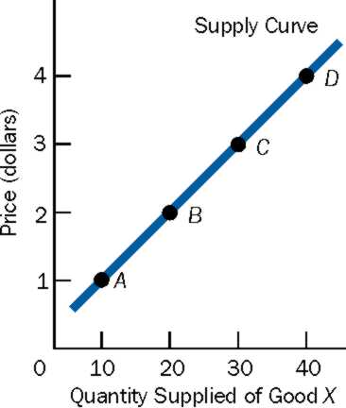
Supply Curve
The upward-sloping supply curve is the graphical representation of the law of supply.
Upward sloping, as per law of supply, ceteris paribus.
Price (y-axis) represents price per unit of a good.
Quantity Supplied (x-axis) at each price for a specific period of time (a week, month,etc)

Slide 14
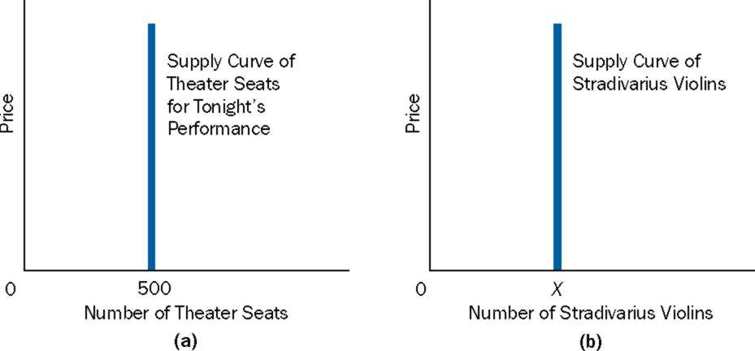
Supply (Cont)
The law of supply does holds for the production of most goods.
However, it does not hold in two cases.
It does not hold when there is no time to produce more units of a good.
The law of supply does not hold for goods that cannot be produced over a period of time.

Slide 15
Supply (Cont)
Why Most Supply Curves are Upward sloping?
➔ Increasing opportunity costs ➔ costs rise as more units of goods are produced.
Individual Supply Curve: Represents price-quantity combinations of a SINGLE seller
Market Supply Curve: Represents price-quantity combinations of a ALL sellers
Market supply curve is derived by “adding” individual supply curves

Slide 16
Deriving a Market Supply Schedule and a Market Supply Curve
(a)
(b)

Slide 17
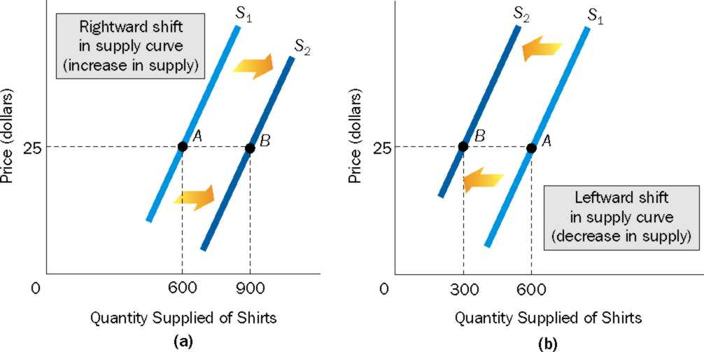
Changes in Supply Means Shifts in Supply Curves
Suppliers are willing and able to produce and offer to sell more (less) of the good at all prices ➔ demand shifts right (left).

Slide 18
What Factors Cause the Supply Curve to Shift?
The following causes the supply curve to SHIFT:
Prices of Relevant Resources
Technology
Prices of other goods
Number of Sellers
Expectations of Future Prices
Taxes and subsidies
Government Restrictions

Slide 19
What Factors Cause the Supply Curve to Shift?
PRICES OF RELEVANT RESOURCES: Resources are needed to produce goods. Example?
TECHNOLOGY: Defined as the body of skills and knowledge concerning the use of resources in production. Also, advancement in technology refers to the ability to produce more output with a fixed amount of resources, thus reducing per unit costs.
PRICES OF OTHER GOODS: Change in price of one good leads to a change in the supply of another good.

Slide 20
What Factors Cause the Supply Curve to Shift?
NUMBER OF SELLERS: If a good is profitable ➔ number of seller increases ➔ Supply increases ➔ shift to right.
EXPECTATIONS ON FUTURE PRICES: if future prices ➔ producers may hold back the products and sell at a later date, when prices may be higher ➔ Current Supply ➔ Supply shifts left.

Slide 21
What Factors Cause the Supply Curve to Shift?
TAXES AND SUBSIDIES:
Taxes: If per-unit tax that needs to paid to government increases ➔ Per unit cost increases ➔cost of production rises and prices unchanged ➔ profit from each unit decreases ➔ decreased incentive to produce more ➔ produce and offer to sell less at each and every prices ➔ supply decreases ➔ shifts left.
Subsidy: A monetary payment by the government to a producer of a good or service. If per unit subsidy ➔ Per unit cost decreases ➔ cost of production falls and prices unchanged ➔ profit from each unit increases ➔ increased incentive to produce more ➔ produce and offer to sell more at each and every prices ➔ supply increases ➔ shifts right.

Slide 22
What Factors Cause the Supply Curve to Shift?
GOVERNMENT RESTRICTIONS:
Government may put certain restrictions. Two examples:
Import Quota
Licensure: With licensure, individuals must meet certain requirements before they can legally carry out a task.

Slide 23
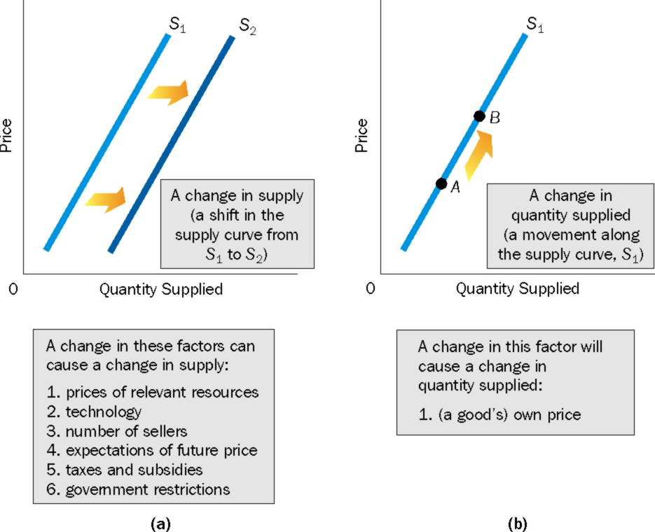
A Change in Supply versus a Change in Quantity Supplied

Slide 24
Demand and Supply
The price at which quantity demanded equal quantity supplied is the equilibrium/market-clearing price. This is the value corresponding to the demand and supply curve intersection at the vertical axis. The quantity that corresponds to the equilibrium price or market clearing price is the equilibrium quantity.
If Quantity Supplied > Quantity Demanded, then a surplus/excess supply situation exists (for any price above the equilibrium price)
If Quantity Demanded > Quantity Supplied, then a shortage/ excess demand situation exists (for any price below the equilibrium price)
Any market that exhibits a shortage or a surplus is said to be in disequilibrium. Any market where the quantity demanded equals quantity supplied is in equilibrium.

Slide 25
Demand and Supply (Cont.)
If there is a surplus, then prices fall. If there is a shortage, then prices rise.
Why does price fall when there is a surplus?
If the sellers want to reduce their warehouse stocks, then they have to reduce the price so that more people can afford to buy them. Other sellers may have to cut back production, i.e. reduce the amount of produced/quantity supplied.

Slide 26
Demand and Supply (Cont.)
Why do prices rise when there is a shortage?
Consumers compete for limited supply of the good by offering a higher price. Sellers take advantage of this and raise the price. When price increases, quantity supplied increases as well as other producers attracted by the higher price floods the market.

