Slide 1
SUPPLY AND DEMAND THEORY (PART 1)
DEMAND

Slide 2
What is Demand?
Demand: The willingness and ability of buyers to purchase different quantities of a good at different prices during a specific time period.
Demand exists when both ability and willingness exists.
I may want to buy a new car, but I cannot afford it then it cannot be called demand.
I can afford to buy cigarettes, but if I do not want it then it cannot be called demand.

Slide 3
The Law of Demand
The Law of Demand states that as the price of a goods rises, the quantity demand of the good falls, and as the price of a good falls, the quantity demanded of the good rises, ceteris paribus.
In other words, the law of demand states that the price of a good and the quantity demanded of the good are inversely related, ceteris paribus.
What does this imply about the slope of the demand curve?
Do the terms quantity demand and demand mean the same thing?

Slide 4
The law of Demand (Cont)
Ceteris Paribus: A Latin term meaning “all other things constant” or “nothing else changes”.
Four ways to Represent Law of Demand
In words
In symbols
In a demand schedule.
As a demand curve.
Definition of a Demand Curve: A downward-sloping demand curve is a graphical representation of the inverse relationship between price and quantity demanded, specified by law of demand.

Slide 5
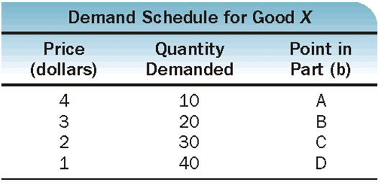
Can you Plot This?
What do we know about the slope? Is it upward sloping or downward sloping?

Slide 6
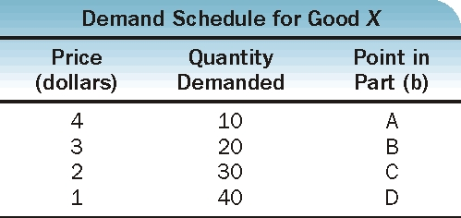
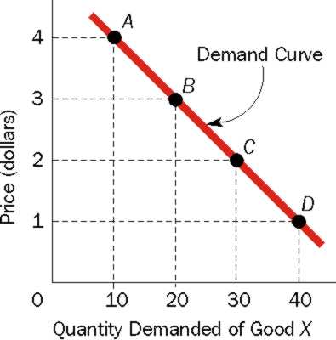
Exhibit 1 Demand Schedule and Demand Curve
(a)
(b)

Slide 7
Two Prices: Absolute and Relative
Absolute Price: The price of a good in money terms. Example: Let the absolute price of a car be $30,000 and the absolute price of a computer be $2000.
Relative Price: The price of a good in terms of another good (the price of an apple is relatively less than the price of a burger).
Why is the relative price? Can we interpret this?
What happens to the relative price of a good when absolute prices increases and ceteris paribus?

Slide 8
Why does Quantity Demanded Go Down as Price Goes Up?
We know that they are inversely related. Do we know WHY this is so?
There are two reasons:
People substitute lower priced goods for higher priced goods
Law of Diminishing Marginal Returns: For a given time period, the marginal (additional) utility or satisfaction gained by consuming equal successive units will decline as the amount consumed increases.

Slide 9
Individual Demand Curve and Market Demand Curve
Individual Demand Curve: It represents the price-quantity combinations of a particular good for a SINGLE buyer.
Market Demand Curve: It represents the price-quantity combinations of a particular good for ALL buyers.
A Market demand curve is derived by “adding up” individual demand curves.

Slide 10
Exhibit 2 Deriving a Market Demand Schedule and a Market Demand Curve
(a)
(b)

Slide 11
Lets Do Try the First two Lines to find and draw Market Demand
Draw the market demand curve.

Slide 12
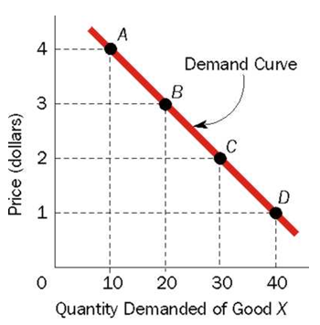
A Change in Quantity Demanded Vs a Change in Demand
CHANGE IN QUANTITY DEMANDED:
Say demand falls from 20 units to 10 units because price increased from $3 to $4.
Is this a change in quantity demanded or change in demand?
A movement from one point to another point on the same demand curve caused by a change in the price of the goods ➔ Change in quantity demanded

Slide 13
Change in Demand
Demand is represented by the entire curve. Therefore, if there is a change in demand ➔ shift in the entire curve.
Demand can increase or decrease. Look at the following schedule:
Price
Price | Quantity Demanded
20 | 500
15 | 600
10 | 700
5 | 800

Slide 14
Increase in Demand
In means that individuals are willing and able to buy more units of the good at each and every price.
Let’s plot this.
Which way does the curve shift?
Price | Quantity Demanded (old) | Quantity Demanded (new)
20 | 500 | 600
15 | 600 | 700
10 | 700 | 800
5 | 800 | 900

Slide 15
Decrease in Demand
In means that individuals are willing and able to buy less units of the good at each and every price.
Let’s plot this.
Which way does the curve shift?
Price | Quantity Demanded (old) | Quantity Demanded (new)
20 | 500 | 400
15 | 600 | 500
10 | 700 | 600
5 | 800 | 700

