Slide 1
Monopoly (Part 2)
Chapter 21

Slide 2
Price and Output for a Profit-Maximizing Monopolist
Profit Maximizing Condition: MR = MC
The monopolist that seeks to maximize profits produces the quantity of output at which MR=MC and charges the highest price per unit at which this quantity of output can be sold.
A monopolists can also make profits and loses, after taking into consideration Average Total Costs.
A monopolist can incur a loss if the highest possible price charged at MR = MC is less than the ATC at that point

Slide 3
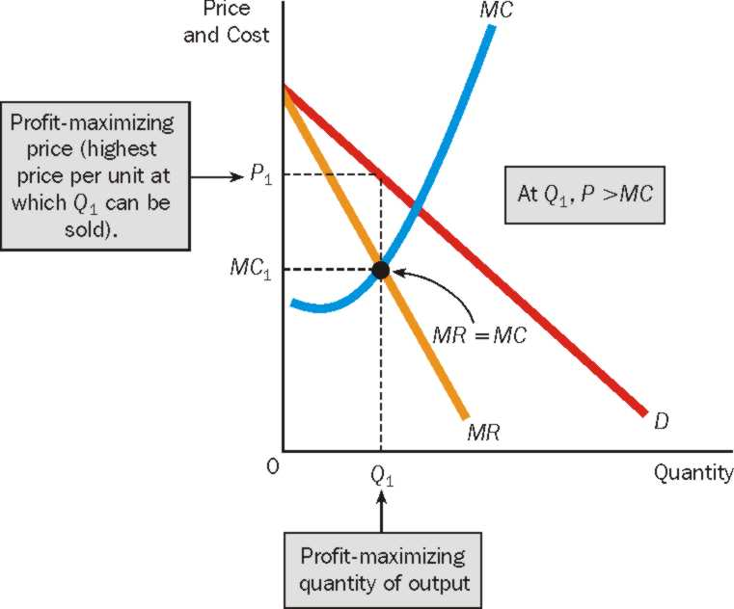
The Monopolist’s Profit-Maximizing Price and Quantity of Output
The monopolist produces the quantity of output (Q₁) at which MR=MC, and charges the highest price per unit at which the quantity of output can be sold (P₁). Notice that at the profit maximizing quantity of output, price is greater than marginal cost, P>MC.

Slide 4
Perfect Competition and Monopoly
For the perfectly competitive firm, P=MR; for the monopolist, P>MR. The perfectly competitive firm’s demand curve is its marginal revenue curve; the monopolist’s demand curve lies above its marginal revenue curve
The perfectly competitive firm charges a price equal to marginal cost; the monopolist charges a price greater than marginal cost.
A monopoly firm differs from a perfectly competitive firm in terms of how much consumers’ surplus buyers receive.

Slide 5
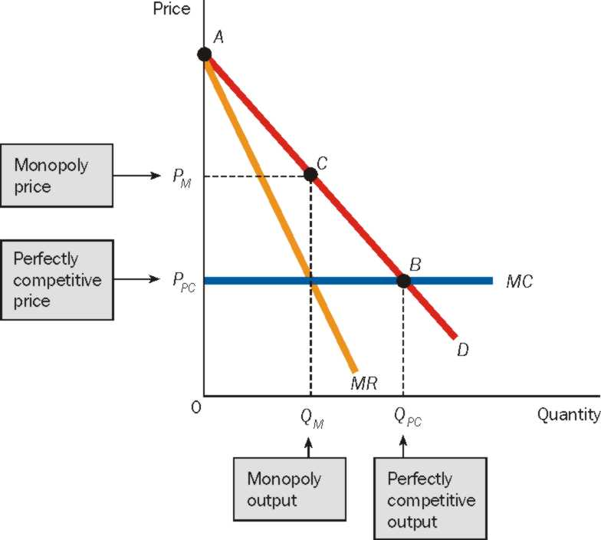
Monopoly, Perfect Competition, and Consumers’ Surplus
Would you, as a consumer prefer a monopoly or a perfectively competitive market?

Slide 6
The Case Against Monopoly: Deadweight Loss
The Deadweight Loss of Monopoly: Greater output is produced under perfect competition than under monopoly. The net value of the difference in these two output levels is said to be the deadweight loss of monopoly.
The difference in output results in a welfare loss to the society.

Slide 7
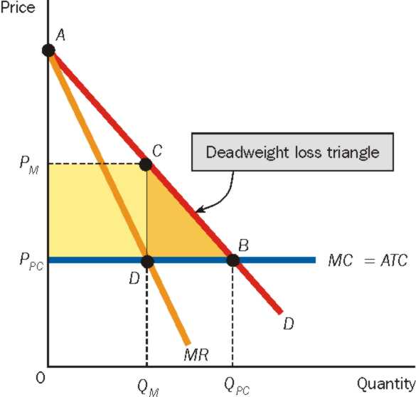
The Case Against Monopoly: Deadweight Loss
The monopolist produces Q_{M}, and the perfectly competitive firm produces the higher output level Q_{PC}
The monopolist also charges a higher price than perfectly competitive firms.

