Slide 1
Production and Costs (Part 3)
Chapter 19.

Slide 2
Production and Costs In The Long Run
In the long run, no inputs are fixed inputs and no fixed costs
All costs are variable ➔ Firm has greater flexibility in long run.
Long-run Average Total Cost
TVC = TC (TFC = 0 in long run)
Long Run Average Total Cost Curve

Slide 3
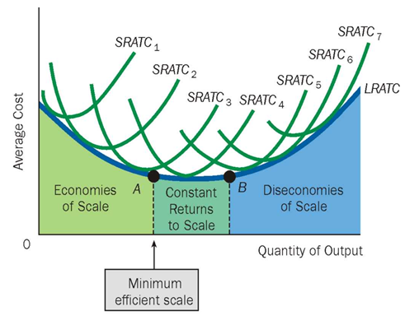
Production and Costs In The Long Run

Slide 4
Economies of Scale, Diseconomies of Scale and Constant Returns to Scale
Economies of Scale exist when inputs are increased by some percentage and output increases by a greater percentage, causing unit costs to fall. ➔ LRATC is falling
Constant Returns to Scale exist when inputs are increased by some percentage and output increases by an equal percentage, causing unit costs to remain constant. ➔ LRATC is constant
Diseconomies of Scale exist when inputs are increased by some percentage and output increases by a smaller percentage, causing unit costs to rise. ➔ LRATC is rising
Minimum Efficient Scale is the lowest output level at which average total costs are minimized.

Slide 5
Why Economies of Scale?
Up to a Certain Point, Long – Run unit Costs of Production Fall as a Firm Grows because of the following reasons:
Growing firms offer greater opportunities for employees to specialize.
Growing firms can take advantage of highly efficient mass production techniques and equipment that ordinarily require large setup costs and thus are economical only if they can be spread over a large number of units

Slide 6
Why Diseconomies of Scale?
Arises due to the following issues coming up because the firm is too big:
Difficulty in coordinating work activities
Communicate the tasks to the right people in a timely way
Monitoring employees effectively
These are avoided by:
Reorganizing and dividing tasks and operations ➔ more specialization
Hire new managers, etc.

