Slide 1
Consumer Choice: Maximizing Utility and Behavioural Economics

Slide 2
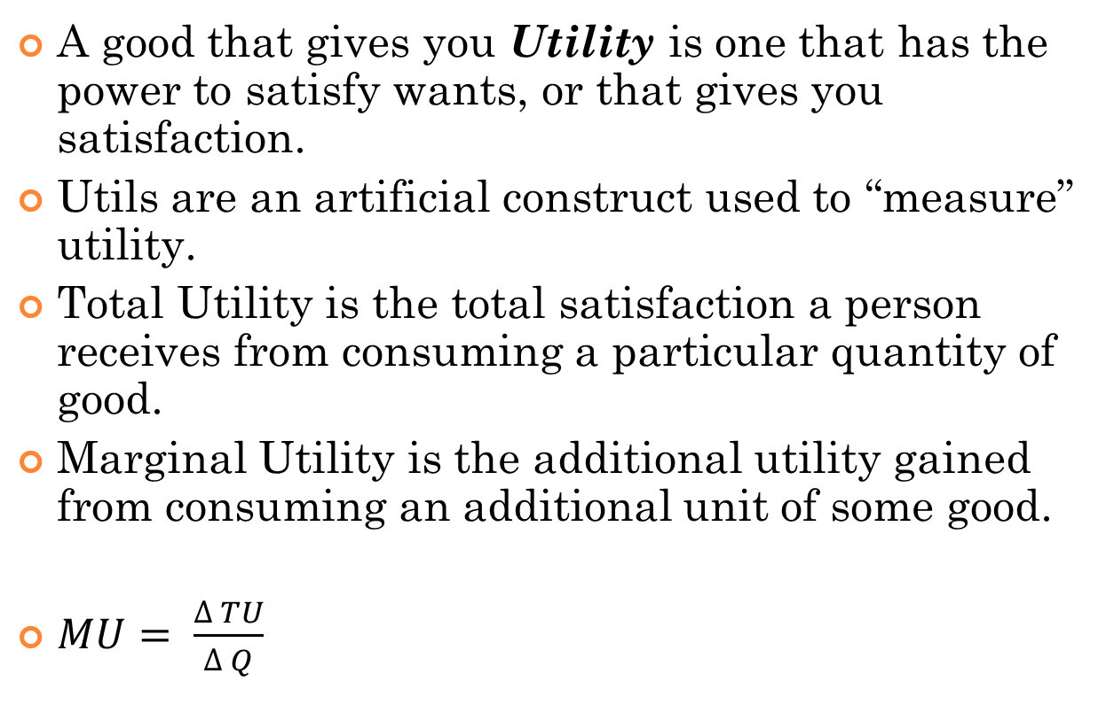
Utility Theory
A good that gives you Utility is one that has the power to satisfy wants, or that gives you satisfaction.
Utils are an artificial construct used to “measure” utility.
Total Utility is the total satisfaction a person receives from consuming a particular quantity of good.
Marginal Utility is the additional utility gained from consuming an additional unit of some good.
$MU= \frac{∆ TU}{∆ Q}$

Slide 3
Example
Number of Apples | Total Utility | Marginal Utility
1 | 10 | 10
2 | 19 | 9
3 | 27 | 8

Slide 4
Law of Diminishing Marginal Utility
The law of Diminishing Marginal Utility states that for a given time period, the marginal utility gained by consuming equal successive units of a good will decline as the amount consumed increases.
In other words, the number of utils gained by consuming the second unit (which is greater than the number gained by the third, which is greater than the number gained by the fourth, and so on)
Total utility increases and marginal utility falls

Slide 5
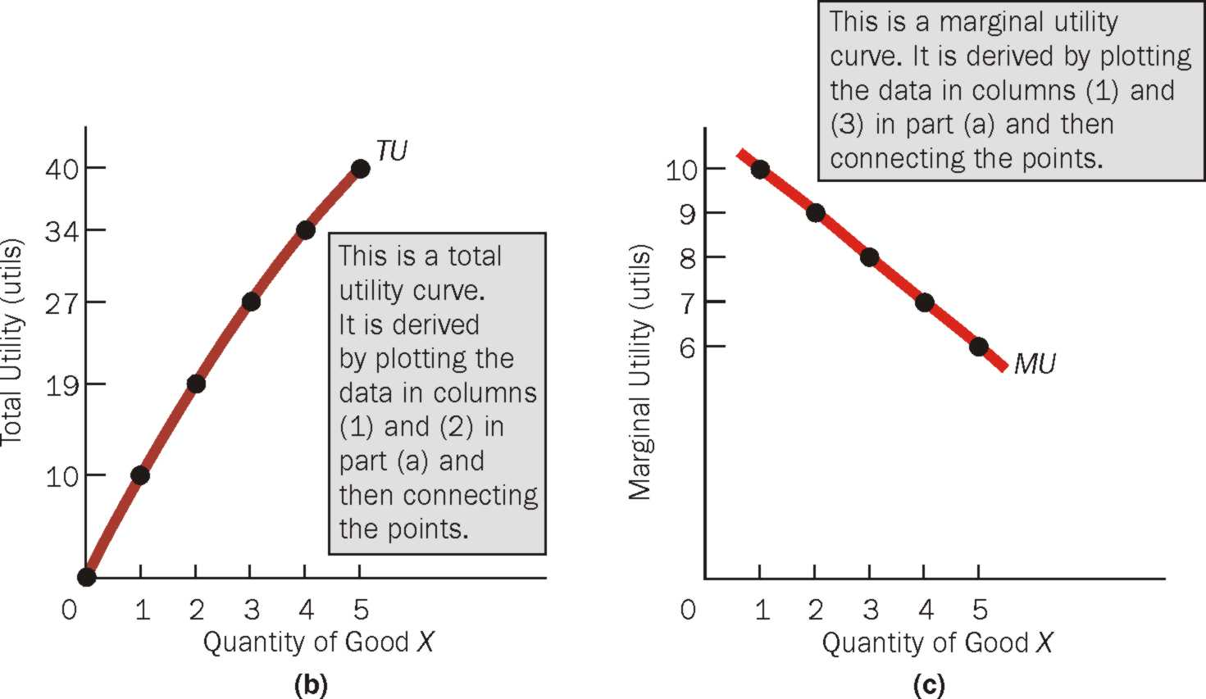
Total Utility, Marginal Utility, and the Law of Diminishing Utility

Slide 6
Law of Diminishing Marginal Utility (Cont)
The law of diminishing marginal utility is based on the idea that if a good has a variety of uses but only one unit of the good is available, then the consumer will use the first unit to satisfy his or her most urgent want.

Slide 7
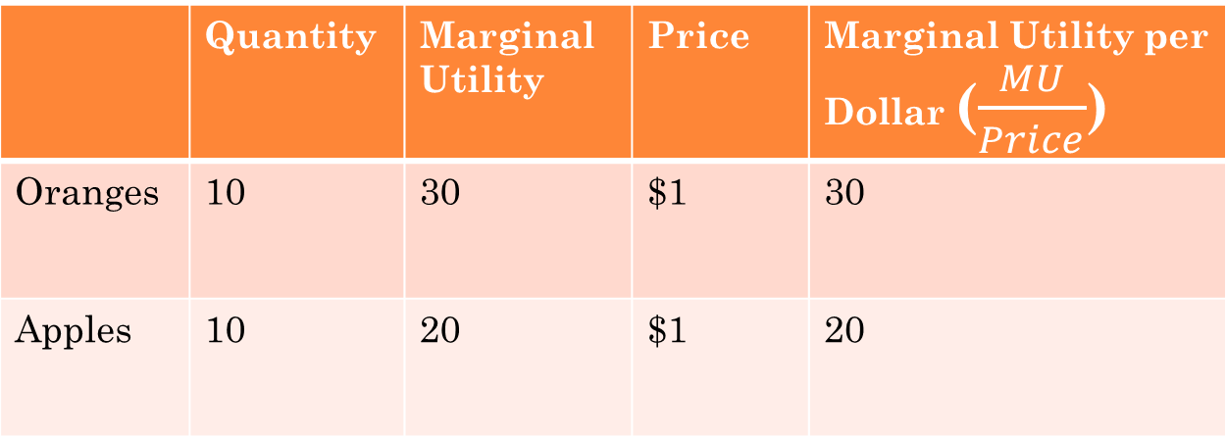
Consumer Equilibrium and Demand
What does consumer or individual aim to maximize by consuming goods and services given the constraints of positive prices and budget?
Equating Marginal Utilities per Dollar
Suppose we have the following information:
 | Quantity | Marginal Utility | Price | Marginal Utility per Dollar ($\frac{MU}{Price}$)
Oranges | 10 | 30 | $1 | 30
Apples | 10 | 20 | $1 | 20

Slide 8
Consumer Equilibrium and Demand
$\frac{{MU}_{O}}{P_{o}} >\frac{{MU}_{A}}{P_{A}}$
What would you do as a consumer?
A consumer is in equilibrium when he derives the same marginal utility per dollar for all goods.
Consumer Equilibrium: Equilibrium occurs when the consumer has spent all income and the marginal utilities per dollar spend on each good purchased are equal.
At consumer equilibrium, TU is maximized.

Slide 9
Maximizing Utility and the law of demand
Given the equilibrium condition and price of oranges falls, what happens to this condition?
Utility Maximization is consistent with the law of demand.

