Slide 1
Chapter 14: Analysis of Variance One-way ANOVA Lecture 8
Instructor: Naveen Abedin

Slide 2
Introduction
So far, we have seen how the t-test for “difference in two population means” can be conducted to make inferences about comparing two populations.
If we are interested in making statistical inferences about two or more populations, we can use a technique called the Analysis of Variance (ANOVA)

Slide 3
Introduction (cont.)
The Analysis of Variance technique determines whether differences exist between population means. The procedure however works by analyzing the sample variances.
The procedure was first applied in an experiment to determine whether different treatments of fertilizers produced different crop yields. So this procedure is designed primarily to determine whether there are significant differences between treatment means.
Therefore, ANOVA analyzes the variance of sample data to determine whether we can infer that population means differ. When ANOVA is applied to Independent Samples, it is called One-Way Analysis of Variance.

Slide 4
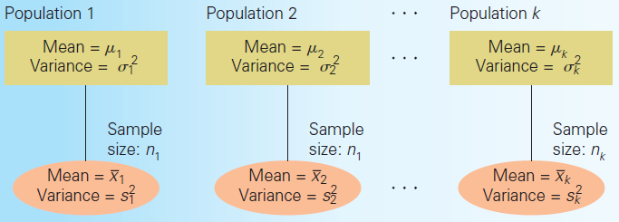
Set up
Consider k populations from which samples have been independently collected:
Let us call the collection of this population j (j = 1, 2, 3…..k). This makes the collection of population parameters and . For each sample we can then calculate and

Slide 5
Example 1
The following example has been taken from pg 520 of the textbook: Do ownership of stocks vary by age? A financial analyst wanting to test this theory gathered a sample of 366 American households, and recorded the age of the head of the household, and asked them what proportion of its financial assets are invested in stock markets. The analyst then split the record according to four age categories. These age categories are referred to as different treatments.

Slide 6
Example 1: STEP 1
Step 1: Set up the test design
Here we are dealing with four populations, so we have four parameters:
The null hypothesis represents the scenario where there are no differences between population means:
The ANOVA determines whether there is enough statistical evidence to show that the null hypothesis is false, so the alternative hypothesis will always be:

Slide 7
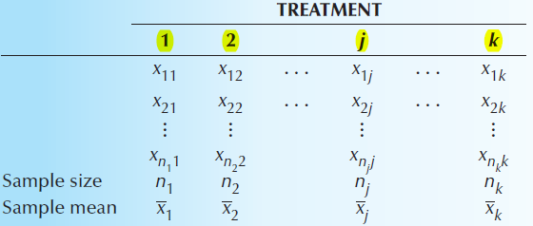
Example 1: STEP 2
Step 2: Calculate the test statistic
Notes:
Suppose that your study of interest has k different treatment populations. You have extracted a sample from each of these k populations, and each sample observation if xij. Total number of observations in each sample is ni. Grand mean is the addition of all observations from all samples divided by the total number of observations from all samples

Slide 8
Example 1: STEP 2 (cont.)
For this study, the different components are:
Response variable: percentage of assets invested in stocks (i.e. what we are observing)
Experimental units: heads of households (the subject interviewed in our samples)
Factor: age. There are 4 factor levels (the variable used to disaggregate our data)

Slide 9
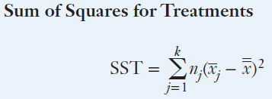
Example 1: STEP 2 (Part 1)
If the null hypothesis is true, the population means would all be equal, and so we would expect the sample means to be close to one another. If the alternative hypothesis is true, we would expect to observe large differences between sample means.
The statistic that measures the proximity (closeness) of the sample means to each other is called the between-treatments variation. It is calculated using SST – Sum of Squares for Treatments.
Notes:
Sum of squares for treatments measures the variation that exists between the treatments, i.e. the variations between the different age categories.

Slide 10
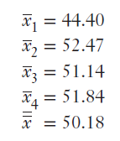
Example 1: STEP 2 (Part 1 cont.)
If the sample means are close to each other, then all of the sample means would be close to the grand mean, and as a result SST would be small. This goes by the intuition that if the sample means were all equal to one another, then SST = 0. A small value of SST would imply that the null hypothesis is probably true.
Notes:
the grand mean is not simply the average of all the sample means. it is adding up all the observations from all the samples and dividing by the total number of observations collected from all the samples.

Slide 11
Example 1: STEP 2 (Part 1 cont.)
If large differences exist between the sample means, then at least some sample means differ considerably from the grand mean producing a large SST. And if SST is significantly large, then we can reject the null hypothesis in favor of alternative hypothesis. Thus the question is, what deems SST to be a significantly large figure.

Slide 12
Example 1: STEP 2 (Part 2)
So the question we are now facing is how large does SST have to be for us to justify rejecting the null hypothesis? To answer this, we need to know how much variation exists within each sample, i.e. how much variation exists in the percentage of assets owned within each sample. This is measured by the within-treatments variation, denoted by SSE – Sum of Squares for Error.
SSE provides a measure of the amount of variation in the response variable that is not caused by the treatments, e.g. other factors besides the age of household head that may influence the amount of stocks purchased, such as income, occupation, family size etc. All of these other sources of variation are lumped together under a single category called error. This source of variation is measured by the Sum of Squares Error.
Notes:
*remember response variable in our study is the amount of stocks owned

Slide 13
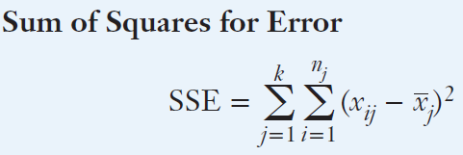
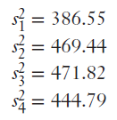
Example 1: STEP 2 (Part 2 cont.)

Slide 14
Example 1: STEP 2 (Part 2 cont.)

Slide 15
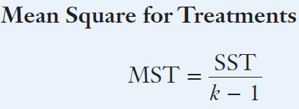
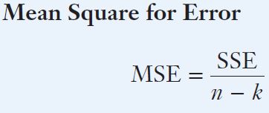
Example 1: STEP 2 (Part 3)
The next step is to calculate the mean squares:
The Mean Square for Treatments is computed by dividing SST by the number of treatments (k) minus 1.
The Mean Square for Error is determined by dividing SSE by the total sample size (n) minus the number of treatments (k)

Slide 16
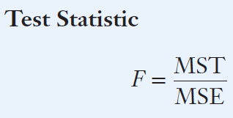
Example 1: STEP 2 (Part 4)
Finally, the test statistic can now be calculated:
The test statistic follows the F-distribution with v1 = k – 1 and v2 = n – k degrees of freedom, where k is the number of treatments and n is the number of observation in total in the entire study.

Slide 17
Example 1: STEP 3 and 4
Step 3: Calculate the Rejection Region
The F-statistic is calculated to determine whether the value of SST is large enough to reject the null hypothesis. SST and F statistic are positively related, so a large enough test statistic will ensure if there is sufficient evidence present to reject the null hypothesis The null hypothesis is rejected if the test statistic, F is higher than Fα, k – 1, n – k .
Step 4: The Decision: We have sufficient evidence to reject the null hypothesis as F = 2.79

Slide 18
ANOVA table
The results of the analysis of variance are usually reported in an analysis of variance (ANOVA) table.

Slide 19
ANOVA table (cont.)
For Example 1, the ANOVA table is:
SS (Total) = SST + SSE
SS (Total) / n – 1 = sample variance

Slide 20
Summary
The analysis of variance tests to determine whether there is evidence of differences between two or more population means. (The t-test done in Chapter 13 can only be used to compare two population means only).
SST: This measures the variation attributed to the differences between the treatment means (variation of each sample mean to the grand mean). If this is statistically significantly high, then we can reject the null hypothesis.
SSE: This measures the variation within samples (differences attributed to other causes besides the factor). It represents the variations that is unexplained by the different treatments.

