Slide 1
Chapter 13: Inferences about Comparing Two Populations
Instructor: Naveen Abedin

Slide 2
Matched pairs experiment (non-independent samples)
A matched pair design can be used when an experiment has only two treatment conditions, and subjects can be grouped into pairs based on some blocking variable. Then within each pair, subjects are randomly assigned to different treatments.
Example: suppose a group of 1000 subjects has been chosen where each receive one of two treatments – a placebo or a cold vaccine. The 1000 subjects are grouped into 500 matched pairs. Each pair is matched on gender and age (the blocking variables). For example, pair 1 might be two women , both of age 21. Pair 2 might be two mean, both of age 25, and so on.

Slide 3
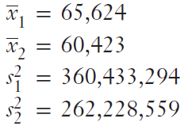
Example 1: Part 1 (using independent samples)

Slide 4
Example 1: Part 1 (using independent samples) (cont.)
The experiment shows that p-value is 0.1513, indicating there is very little evidence in support of the alternative hypothesis that finance majors receive higher salary offers than marketing majors.
Notice however, there is some indication (albeit vague) that the alternative hypothesis is true.
The difference between the sample means are quite large, $5,201. However, we judge statistical difference not with regards to difference in sample means, but with regards to sample error.
This shows us that although difference between sample means was quite large, the variability of the data measured by the standard error was also large, resulting in smaller statistical difference.

Slide 5
Example 1: Part 2 (using matched-pair samples)
In order to reduce the variability existing between the sample data, we need to control for any significant determining force. GPA is the major determining force for job offers, for students graduating from both majors. If two students graduate with the same GPA, but one is a finance major and the other is a marketing major, which one is more likely to get a higher-salary job offer?
If we are able to pair students in the sample according to their GPAs, where one member of the pair is a finance major and the other a marketing major, then we can reduce the variability between the two samples caused formerly by not controlling for student grades.
Notes:
Disaggregating the data

Slide 6
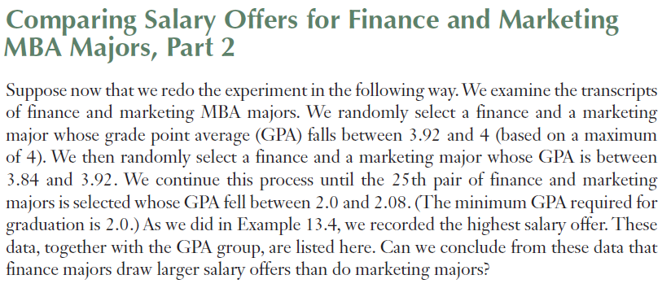
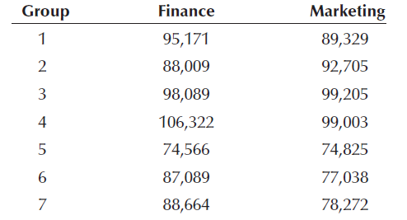

Slide 7
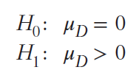
Example 1: Part 2 (using matched-pair samples)
To conduct the matched pairs experiment, we need to calculate the difference in means.
This now makes the parameter of interest the “mean of population differences” (μD)

Slide 8
Independent Sample vs. Matched Pair
Matched pairs experiment is a good options to use when we want to reduce variation in the data.
Independent samples standard error = 4991
Matched pairs standard error = 1329
Matched pairs will not always necessarily produce a large test statistic (making it more prone to rejection).
Using matched pairs inappropriately may actually make it less likely to reject the null hypothesis because the degrees of freedom under matched pairs (24) is nearly as half as the independent samples (48). With a smaller degrees of freedom, the test statistic yields a larger p-value.
The “mean of population differences”(μD) depends on the normality of differences. This again can be checked by charting a histogram of differences.
Notes:
P-value is larger because of thicker tails

