Slide 1
Chapter 12: Inference about a Population Lecture 6a
Instructor: Naveen Abedin

Slide 2
Introduction
In previous chapters, statistical inferences were made based on the assumption that the population standard deviation, σ, is known. However, it is more common and realistic to encounter a situation where both μ and σ are unknown.

Slide 3
Introduction (cont.)
When μ is unknown but σ is known, we can use the standardized normal distribution for estimation and hypothesis testing
When μ and σ are both unknown, we can no longer use the z-statistic because we do not know what σ is. Instead we have to use the best estimator of σ, which is the sample standard deviation, s, to compute a t-statistic to conduct statistical inferences about the population:
where t follows the Student t-distribution when the sampled population is normal

Slide 4
Introduction (cont.)
Confidence Interval when μ and σ are both unknown

Slide 5
When to use t-distribution?
If population mean and variance are both unknown, the t-distribution can be used to estimate these parameters if the sample size n is sufficiently large based on the following scenarios:
The population distribution is normal or near normal, smaller than 30 sample size may be used
If population distribution is not normal, n ≥ 30 is usually adequate
If population distribution is highly skewed or has outliers, n ≥ 50 should be used

Slide 6
Example 1
The high school athletic director is asked if football players are doing well academically as the other student athletes. We know from a previous study that the average GPA for the student athletes is 3.10. After an initiative to help improve the GPA of student athletes, the athletic director randomly samples 20 football players and finds that the average GPA of the sample is 3.18 with a sample standard deviation of 0.54. Is there a significant improvement? Use a 0.05 significance level.

Slide 7
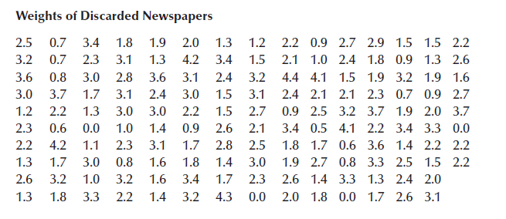
Example 2
Recent studies have found that it is profitable to recycle newspapers. Many companies have gone into the business of collecting used newspapers from households and recycling them. A major expense however is the collection of old newspapers from homes. A financial analyst has computed that the firm would make a profit if the mean weekly newspaper collection from each household exceeded 2.0 pounds. In a study to determine the feasibility of a recycling plant, a random sample of 148 households was drawn from a large community, and the weekly weight of discarded newspapers was recorded. Is there sufficient evidence to allow the analyst to conclude that the recycling plant would be profitable at 1% significance level?

Slide 8
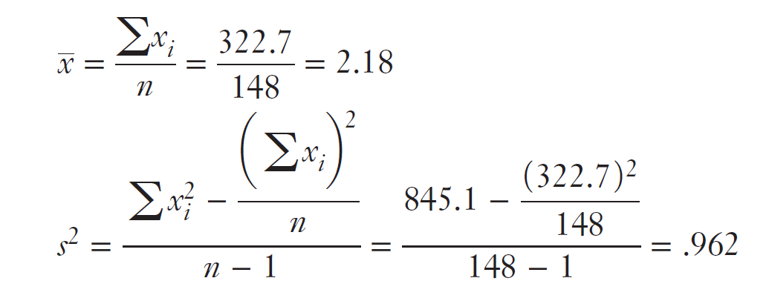
Example 2: Sample Statistics

Slide 9
T-statistic is Robust
Previously, it was mentioned that the t-statistic is Student t-distributed if the population from which the sample has been extracted is normal. However, Student t-distribution is said to be robust, meaning that if the population is non-normal, the results of the t-test and confidence interval estimate are still valid provided that the population is not extremely non-normal.

Slide 10
Greater uncertainty
Like z-distribution, the t-distribution is used to is used to measure the statistical difference between sample mean value and the hypothesized population mean value, with the exception that when a t-distribution is used, the population standard deviation is unknown.
The t-distribution is hence wider than the z-distribution because z-distribution deals only with one unknown, μ. But t-distribution deals with two unknowns, μ and σ. With greater uncertainty, the t-distribution displays greater variability around the population parameter.

