Slide 1
ECO 101: Demand and Supply
Lecture 6b

Slide 2
Consumer Surplus & Producer Surplus
Consumer Surplus: Difference between the maximum price a buyer is willing and able to pay for a good or service and the price actually paid by the buyer. e.g. if the highest price a consumer is willing to pay to watch the movies if TK. 100, but the ticket costs only TK. 50, then your consumer surplus is
Producer Surplus: The difference between the price sellers receive for a good and the minimum or lowest price for which they would have sold the good. Suppose the minimum price the producer is willing to sell a movie ticket for is TK. 50, but he sells it for TK. 100. Then his producer surplus is:

Slide 3
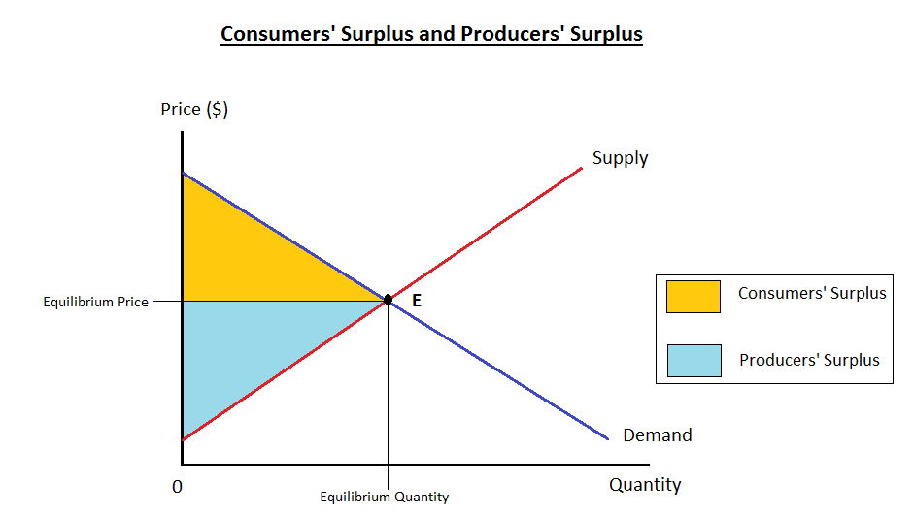
Consumer Surplus & Producer Surplus

Slide 4
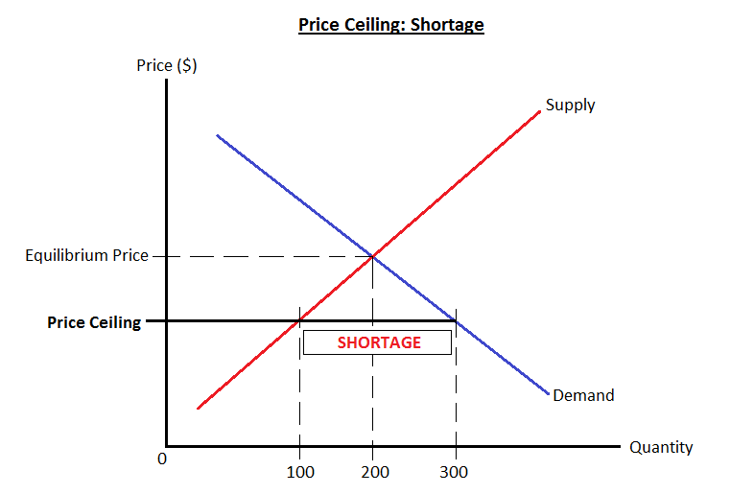
Price Ceiling
Price Ceiling: A government-mandated maximum price above which legal trades cannot be made.
Effects of price ceiling:
Shortage: Suppose the market equilibrium price is Pe. The government now introduces a price ceiling of price P1 (P1 < Pe)

Slide 5
Price Ceiling (cont.)
Fewer Exchanges: At the equilibrium price, the quantity that would have been supplied and bought is 200. However at the price ceiling, the quantity sold will be only 100, although buyers would prefer to buy 300 units.
Non-Price Rationing Devices: First-come-first-served
Buying and Selling at Prohibited Prices.

Slide 6
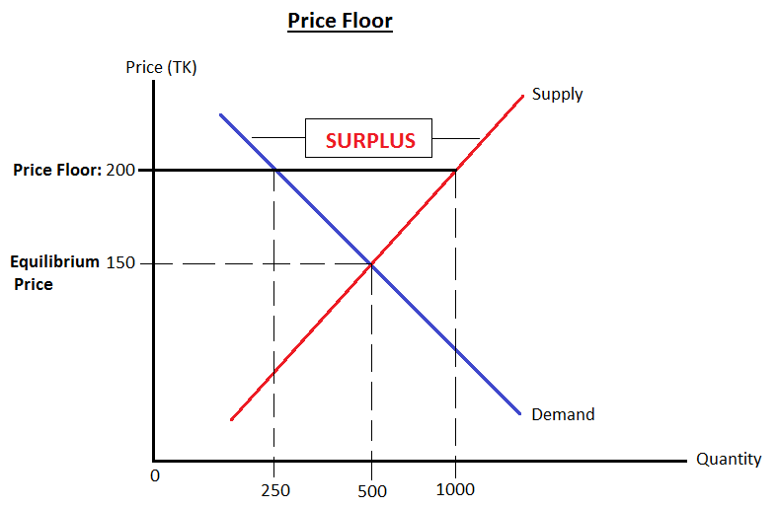
Price Floor
Price Floors: The minimum price below which no legal trade can be made.
Surplus: Suppose equilibrium price is $150. The government sets a price floor at $200.
Fewer Exchanges

