Slide 1
Monopoly (Part 1)
Chapter 21

Slide 2
The Theory of Monopoly
The theory is based on three assumptions:
There is one seller.
The single seller sells a product for which there is no close substitute
There are extremely high barriers to entry

Slide 3
Barriers to Entry: A Key to Understanding Monopoly
Legal Barriers: Three types:
Public Franchise is a right granted to a firm by government that permits the firm to provide a particular good or service and excludes all others from doing the same.
Patents
Licenses
Economies of Scale: In some industries, low average total costs are only obtained through large scale production. If only one firm can survive in that industry, the firm is called a Natural Monopoly.
Exclusive Ownership of a Necessary Resource: Existing firms may be protected from entry of new firms by the exclusive or near-exclusive ownership of a resource needed to enter the industry

Slide 4
What is the Difference Between a Government Monopoly and a Market Monopoly?
Some economists use the term government monopoly to refer to monopolies that are legally protected from competition through Patents, Licenses, Public Franchises ➔ Legally Prohibited.
The term market monopoly to refer to monopolies that are not legally protected from competition. The barriers take form of Economies of Scale and Exclusive ownership of resource.

Slide 5
Monopoly Pricing and Output Decision
A monopolist is a PRICE SEARCHER.
Price Searcher: A seller that has the ability to control to some degree the price of the product it sells.
Unlike the a Perfectly Competitive firm, it can raise price or lower prices and still sell the product.
This ability is determined by the demand curve it faces ➔ which is also the market/industry demand curve ➔ DOWNWARD SLOPING DEMAND CURVE

Slide 6
The Monopolist’s Demand and Marginal Revenue Curves are NOT Same
In Perfect Competition: P = MR
In Monopoly: P > MR
Price is determined by Demand. So Demand Curve lies ABOVE MR curve.
For first unit, P = MR, for second unit onwards, P > MR
Therefore: In monopoly, the firm’s demand curve is not the same as its marginal revenue curve. The monopolist’s demand curve lies above its marginal revenue curve

Slide 7
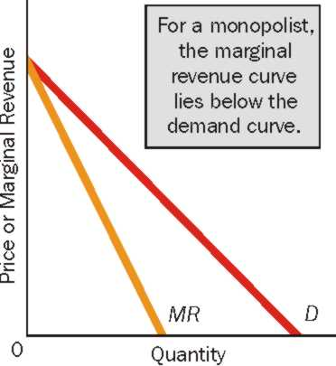
The Monopolist’s Demand and Marginal Revenue Curves are NOT Same

