Slide 1
Perfect Competition (Part 2)
Chapter 20

Slide 2
The Perfectly Competitive Firm and resource Allocative Efficiency
Producing a good – any good – until price is equal to marginal cost ensures that all units of the good are produced that are of greater value to buyers than the alternative goods that might have been produced.
Resource Allocative Efficiency: The situation when firms produce the quantity of output at which price equals marginal cost, P = MC.
A perfectly competitive firm always achieves resource allocative efficiency.

Slide 3
To Produce or Not to Produce: That is the Question
The firm will continue to increase its quantity of output as long as marginal revenue is greater than marginal cost.
The firm will stop increasing its quantity of output when marginal revenue and marginal cost are equal
The Profit Maximization Rule: Produce the quantity of output at which MR=MC

Slide 4
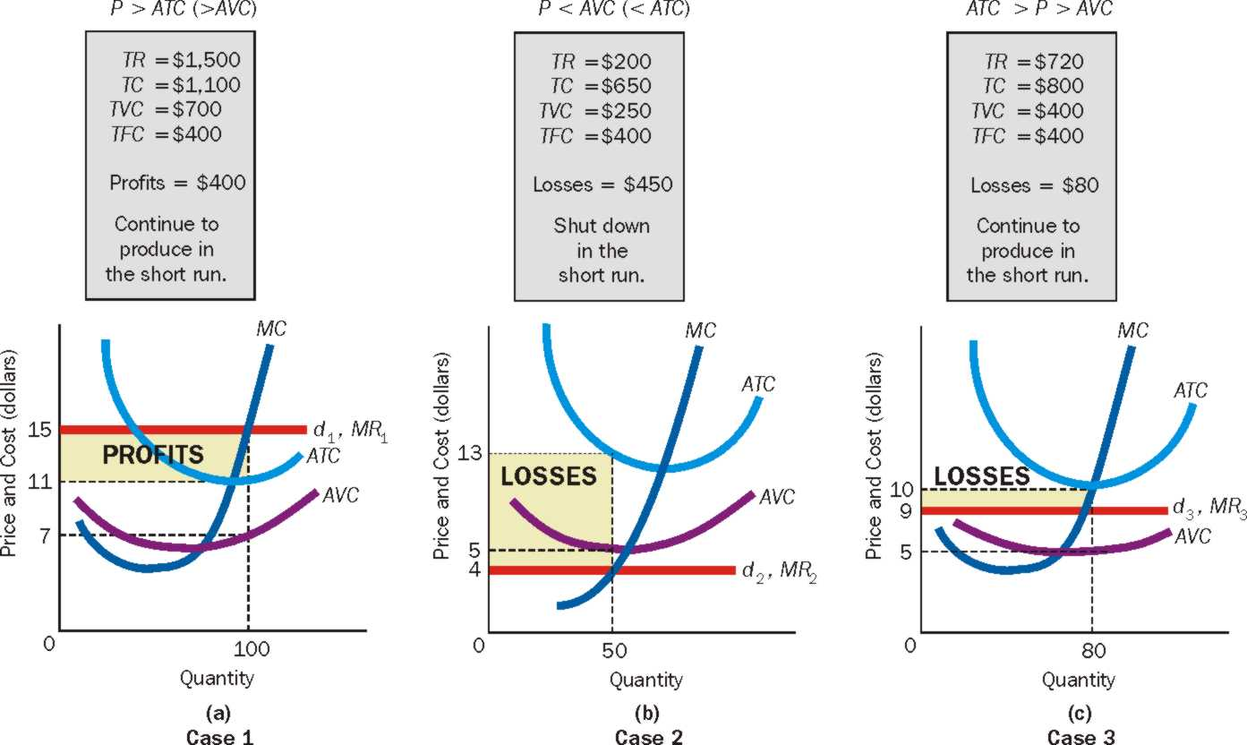
To Produce or Not to Produce: That is the Question

Slide 5
Summary of Cases 1 - 3
A firm produces in the short run as long as price is above average variable cost. (Cases 1 and 3)
P > AVC ➔ Firm Produces
A firm shuts down in the short run if price is less than average variable cost. (Case 2).
P < AVC ➔ Firm Shuts Down
A firm produces in the short run as long as total revenue is greater than total variable costs.
TR > TVC ➔ Firm Produces
A firm shuts down in the short run if total revenue is less than total variable costs.
TR < TVC ➔ Firm Shuts down.

Slide 6
What Should a Firm Do in the Short Run?

Slide 7
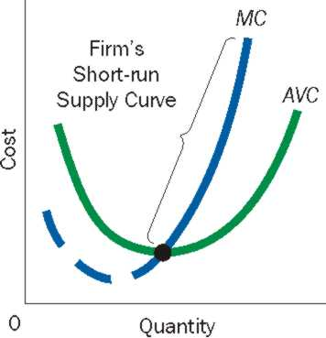
The Perfectly Competitive Firm’s Short – Run Supply Curve
Only a price above average variable cost will induce the firm to supply output.
The Short-Run supply curve is that portion of the firm’s marginal cost curve that lies above the average variable cost curve.

Slide 8
Perfect Competition in the Long Run
For a perfectly competitive firm:
Long run mechanisms:
Positive Economic Profit (in Short Run) ➔ New firms enter industry (free entry) ➔ No. of firms increase till economic profit is zero.
Losses (in Short Run) ➔ Some existing firms exit industry (exit entry) ➔ No. of firms decrease till economic profit is zero.

Slide 9
The Conditions of Long Run Competitive Equilibrium
Condition 1: Economic profit is Zero: Price is equal to short-run average total cost (SRATC)
Positive Economic Profit (in Short Run) ➔ New firms enter industry (free entry) ➔ No. of firms increase till economic profit is zero.
Losses (in Short Run) ➔ Some existing firms exit industry (exit entry) ➔ No. of firms decrease till economic profit is zero.
Long-run equilibrium exists where is there no incentive to enter or exit industry based on profits and losses.
This occurs when P = SRATC (firms have normal profit only).

Slide 10
The Conditions of Long Run Competitive Equilibrium
Condition 2: Firms are producing the quantity of output at which Price is equal to Marginal Cost (MC)
We know profit maximization occurs where MR = MC.
A perfectly competitive firm always has P = MR
Therefore, P = MR = MC

Slide 11
The Conditions of Long Run Competitive Equilibrium
Condition 3: No firm has an incentive to change its plant size to produce its current output; that is, SRATC=LRATC at the quantity of output at which P=MC.
If SRATC > LRATC ➔ Firm wants to change scale of plant so that it can produce at minimum cost.
Overtime is will shift towards the desired plant size, till SRATC = LRATC.
Long-run equilibrium exists where is there no incentive to change plant size.

Slide 12
The Conditions of Long Run Competitive Equilibrium
When all three conditions hold, we have the long-run equilbrium:
Long Run Competitive Equilibrium exists when:
P = MC = SRATC = LRATC
Long-run equilibrium exists where is there no incentive for firms to:
Enter or exit the industry
Produced more of less output
Change plant size

Slide 13
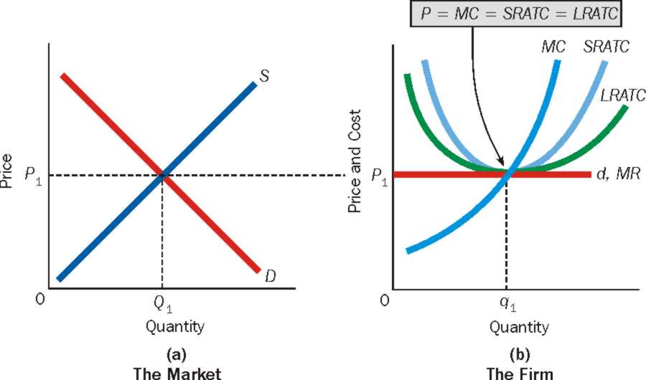
The Conditions of Long Run Competitive Equilibrium

