Slide 1
Perfect Competition (part 1)
Chapter 20

Slide 2
Introduction
Every firm shares two things in common.
Firstly, the need to answer the following questions:
What price should the firm charge for the good it produces and sells?
How many units of the good should the firm produce?
How much of the resources that the firm needs to produce its good should it buy?
Secondly, all firms operate in a certain market structure.
Market Structure: The particular environment of a firm, the characteristics of which influence the firm’s pricing and output decisions.

Slide 3
The Theory of Perfect Competition
The theory of perfect competition is built on four assumptions:
There are many sellers and many buyers, none of which is large in relation to total sales or purchases.
Each firm produces and sells a homogeneous product.
Buyers and sellers have all relevant information about prices, product quality, sources of supply, and so forth.
Firms have easy entry and exit.

Slide 4
A Perfectly Competitive Firm is a Price Taker
A price taker is a seller that does not have the ability to control the price of the product it sells; it takes the price determined in the market.
A firms is restrained from being anything but a price taker if
It finds itself one among many firms where its supply is small relative to the total market supply (inability to influence price)
It sells a homogeneous product
In an environment where buyers and sellers have all relevant information.

Slide 5
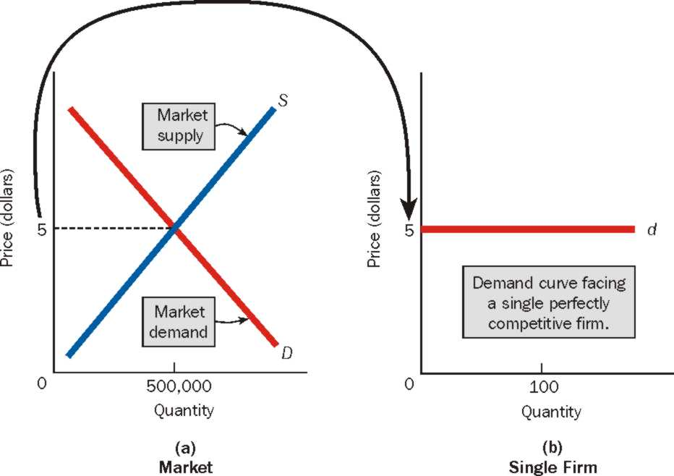
The Demand Curve For a Perfectly Competitive firm is Horizontal
When the equilibrium price has been established, a single perfectly competitive faces a horizontal demand curve at the equilibrium price.
Why does a perfect competitive firm sell at equilibrium price?

Slide 6
The Marginal Revenue Curve of a Perfectly Competitive Firm is the Same as Its Demand Curve
The firm’s marginal revenue is the change in total revenue that results from selling one additional unit of output.
Notice that marginal revenue at any output level is always equal to the equilibrium price. For a perfectly competitive firm, price is equal to marginal revenue.
The marginal revenue curve for the perfectly competitive firm is the same as its demand curve.

Slide 7
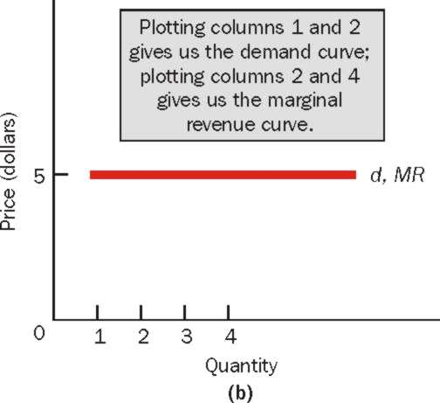
The Marginal Revenue Curve of a Perfectly Competitive Firm is the Same as Its Demand Curve
P = MR = Demand Curve

Slide 8
Theory and Real World Markets
A market that does not meet the assumptions of perfect competition may nonetheless approximate those assumptions to such a degree that it behaves as if it were a perfectly competitive market. If so, the theory of perfect competition can be used to predict the market’s behavior.
Examples of industries which approximately meet the assumptions: Stock market, some agricultural markets, etc.

Slide 9
Perfect Competition
The firm will continue to increase its quantity of output as long as marginal revenue is greater than marginal cost.
The firm will stop increasing its quantity of output when marginal revenue and marginal cost are equal
The Profit – Maximization Rule: Produce the quantity of output at which MR=MC

Slide 10
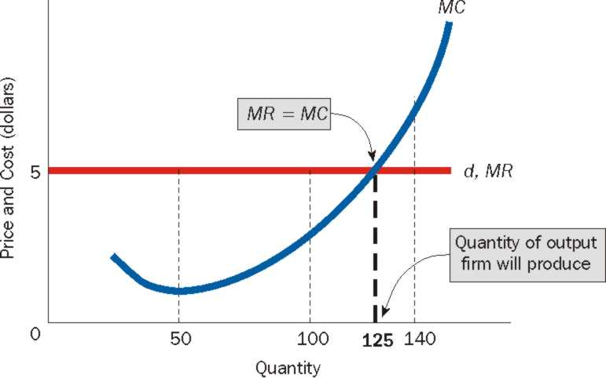
What Level of Output Does the Profit-Maximizing firm Produce?
The firm’s demand curve is horizontal at the equilibrium price. Its demand curve is its marginal revenue curve. The firm produces that quantity of output at which MR=MC

