Slide 1
Production and Costs (Part 1)
Chapter 19: Production and Costs

Slide 2
The Firm’s Objective
Firm’s Objective for producing goods and services ➔ PROFIT MAXIMAZTION
Profit = Total Revenues – Total Cost
Total Revenue = Price per unit * No. of units sold
Total costs can be divided into two types: Explicit costs and implicit costs.
Numerically…

Slide 3
All About Costs
An explicit cost is a cost that is incurred when an actual payment is made.
An implicit cost represents the opportunity cost of using its own resources, that it owns or that the owners of the firm contribute to it.

Slide 4
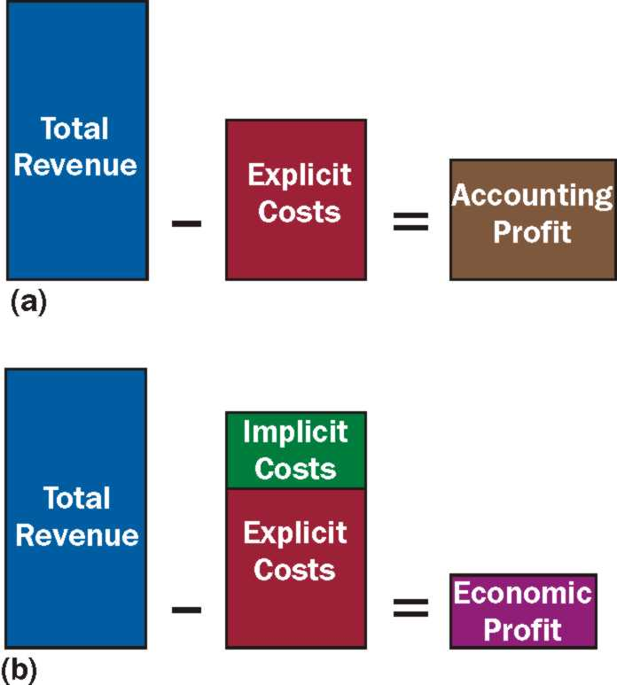
Accounting Profit Versus Economic Profit
Accounting Profit is the difference between total revenue and explicit costs.
Economic Profit is the difference between total revenue and total opportunity cost, including both its explicit and implicit components

Slide 5
Example
Example: Ms. J has decided to open a bakery. She has rented a small shop for $500/month. She has hired two workers whom she pays $600/month each. Her raw materials to bake her desserts cost up to $400/month. Ms. J has an Accounting degree, so if she were working at an accounting firm instead, her could earn $1000/month. Currently she generates a total revenue of $3100/month.
Calculate Ms. J’s Accounting Profit and Economic Profit.

Slide 6
Zero Economic Profit Is Not as bad As it Sounds.
It is possible for a firm to earn both a positive accounting profit and a zero economic profit.
Zero Economic Profit/Normal Profit: A firm that earns normal profit is earning revenue equal to its total costs (implicit and explicit). This is the level of profit necessary to keep resources employed in a firm.
A firm that makes zero economic profit is said to be earning normal profit.
Zero economic profit means the owner has generated total revenues sufficient to cover total opportunity costs.

Slide 7
Production
Production is a transformation of resources or inputs into goods and services.
A fixed input is an input whose quantity cannot be changed as output changes in the short run. The costs associated with fixed inputs are fixed costs. A fixed cost doesn’t change as output changes.
A variable input is an input whose quantity can be changed as output changes in the short run. The costs associated with variable inputs are variable costs. A variable cost changes as output changes
The short run is a period in which some inputs are fixed.
The long run is a period in which all inputs can be varied.

Slide 8
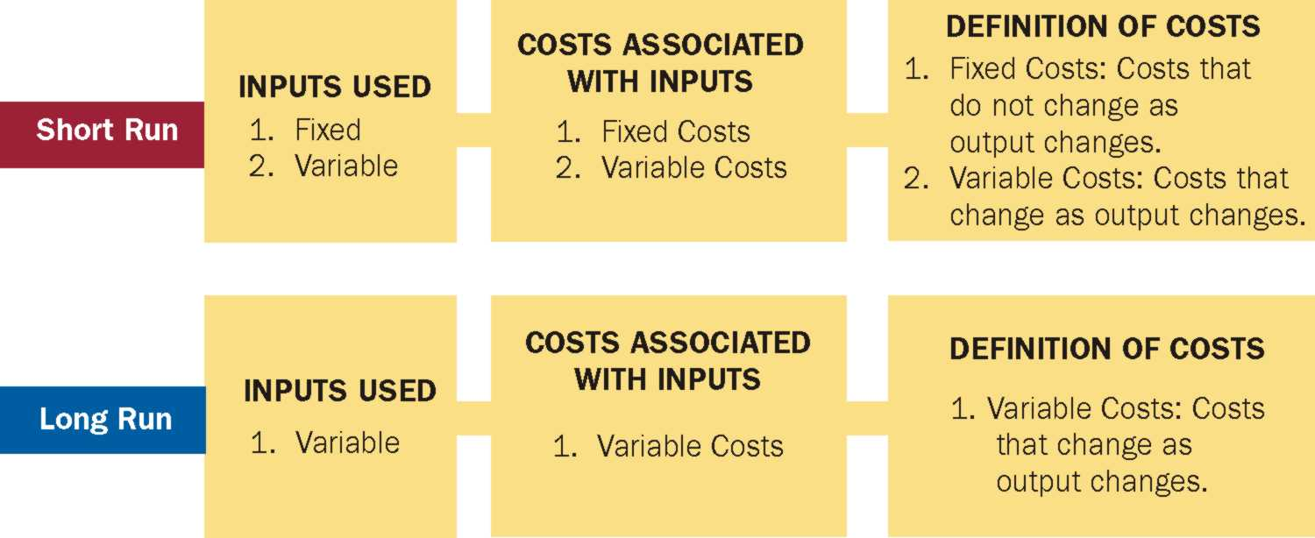

Slide 9
SHORT RUN

Slide 10
Marginal Physical Product and Marginal Cost
SOME ECONOMIC COSTS CONCEPTS:
Fixed Costs: Costs that do not vary with output; the costs associated with fixed inputs. E.g. Rent. Because the quantity of a fixed input does not change as output changes, neither do fixed costs.
Variable Costs: Costs that vary with output, the costs associated with variable inputs. Because the quantity of a variable input changes with output, so do variable costs.
Total costs: Sum of fixed and variable costs

Slide 11
Production in the Short Run
Assume there are two inputs (resources): labour and capital.
Assume capital is fixed (the amount of capital that can be used is fixed).
Are we in the long run or in the short run?
Total Physical Product: The total quantity of output that is produced.
Marginal Physical Product: The change in output that results from changing the variable input by one unit, holding all other inputs fixed.

Slide 12
Example:
Fixed Input, Capital (units) | Variable Input, Labor (workers) | Quantity of Output, Q (units) | Marginal Physical Product of Variable Input
1 | 0 | 0 | 0
1 | 1 | 18 | 18
1 | 2 | 37 | 19
1 | 3 | 57 | 20
1 | 4 | 76 | 19
1 | 5 | 94 | 18
1 | 6 | 111 | 17
1 | 7 | 127 | 16
1 | 8 | 137 | 10
1 | 9 | 133 | -4
1 | 10 | 125 | -8

Slide 13
Production in the Short Run (CONT)
Law of Diminishing Marginal Returns: As even larger amounts of a variable input are combined with fixed inputs, eventually the marginal physical product of the variable input will decline.
The law of diminishing marginal returns says that as more units of the variable input are added, each one has fewer units of the fixed input to work with; consequently, output rises at a decreasing rate.
If the law of diminishing marginal returns did not hold, then it would be possible to continue to add additional units of a variable input to a fixed input, and the marginal physical product of the variable input would never decline. We could increase output indefinitely as long as we continued to add units of a variable input to a fixed input.

Slide 14
Production in the Short Run (CONT)
The point at which the MPP of labour first declines is the point at which diminishing marginal returns are said to have set in.
Marginal costs: The change in total costs that results from a change in output. MC = ∆TC/∆Q
Suppose capital rent (which is a fixed cost) is $40. The cost to hire labor (which is a variable cost) is $20.

Slide 15
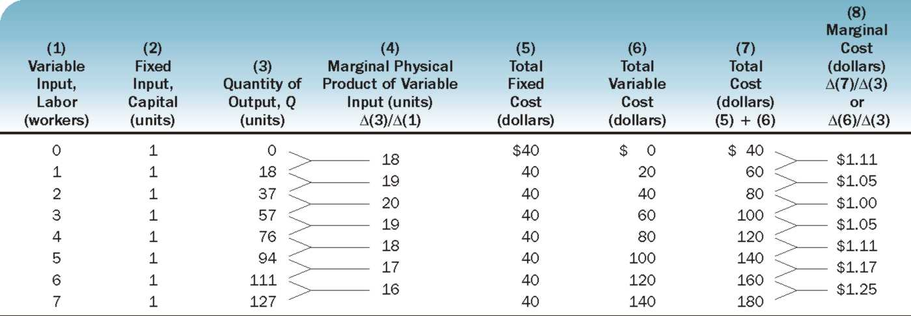
The Link Between MPP and MC

Slide 16
The Link Between MPP and MC
Marginal cost is a reflection of the marginal physical product of the variable input.
As the marginal physical product curve rises, the marginal cost curve falls; and as the marginal physical product curve falls, the marginal cost curve rises.
What the marginal cost curve looks like depends on what the marginal physical product curve looks like.
As MPP rises ➔ productivity of the variable input increases (more output being produced using same input) ➔ costs decline ➔ MC falls
Vice versa!

Slide 17
Costs of Production: Total, Average, Marginal
Average physical product is output divided by the quantity of labor.
The Average Fixed Cost (AFC) = Total fixed cost divided by quantity of output. AFC = TFC/Q
The Average Variable Cost (AVC) = Total variable cost divided by quantity of output. AVC = TVC/Q
The Average Total Cost (ATC) or Unit Cost= Total Cost divided by quantity of output. ATC = TC/Q or ATC = AFC + AVC

Slide 18
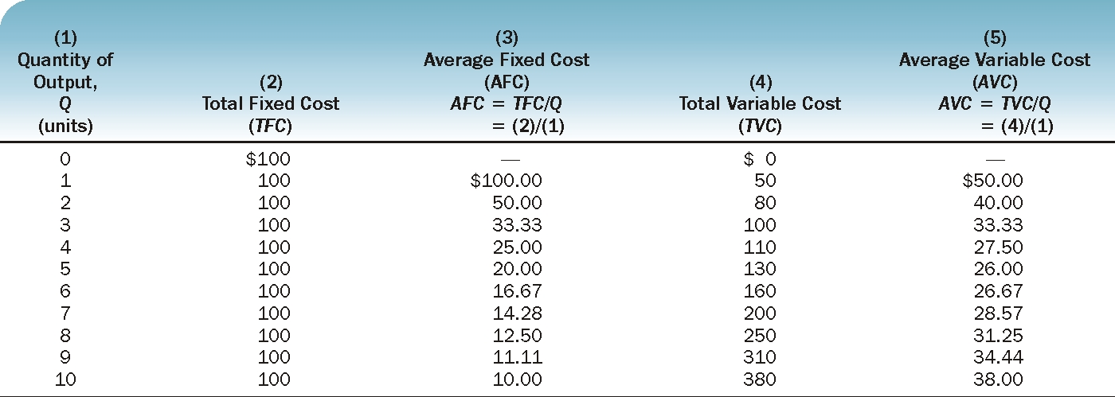

Slide 19
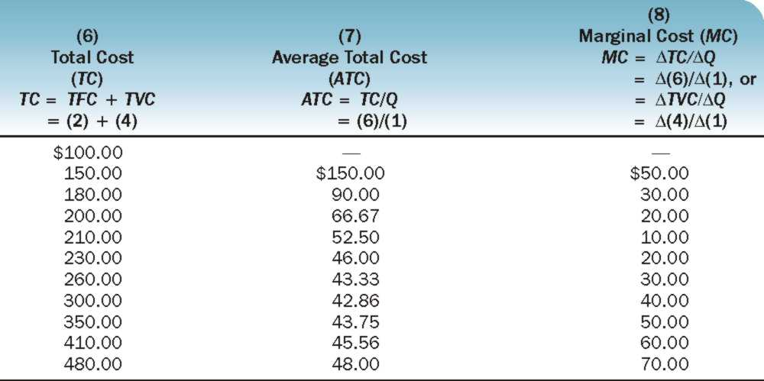

Slide 20
The AVC and ATC Curves in Relation to the MC Curve
The Average – Marginal Rule: When the marginal magnitude is above the average magnitude, the average magnitude rises; when the marginal magnitude is below the average magnitude, the average magnitude falls.

Slide 21
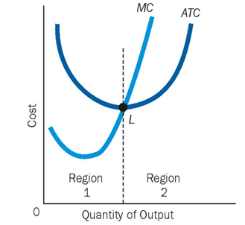
If MC < ATC ➔ ATC is falling; if MC > ATC ➔ ATC is rising, MC = ATC when ATC is minimum

