Slide 1
BUS 173: Applied Statistics
Introductory Lecture
Instructor: Naveen Abedin

Slide 2
Basic concepts and definitions
Population: the group of all items of interest in a study, e.g. all currently enrolled students of North South University; population of Bangladesh
Sample: A sample is a set of data drawn from the studied population, e.g. a sample of 500 students are drawn from the population of all enrolled students in NSU; a sample of 150000 people are drawn from the population of 156,000,000 people in Bangladesh (2010 stats).
The descriptive measure of a population is called a parameter, e.g. average number of soft drinks consumed per day by all students enrolled in NSU.
The descriptive measure of a sample is called a statistic, e.g. average number of soft drinks consumed per day by the sample of students enrolled in NSU

Slide 3
Basic concepts and definitions
Statistical Inference: The process of making an estimate, prediction or decision about a population based on sample data. Most of the time populations are extremely large, and trying to obtain information on each individual member is both impractical and expensive. Hence, samples are drawn from the population to make estimations about the population.

Slide 4
Basic concepts and definitions
Variable: some characteristic of a population or sample that we are interested to measure and study, e.g. income, age, grade, preference
Values: The possible observations of a variable, i.e. the values a variable of interest can take, e.g. semester grade score can be any value between 0 to 100. Sometimes, variables can only take integer values, or coded values (e.g. yes or no; single or married; male or female)

Slide 5
Basic concepts and definitions
There are two types of random variables:
Discrete Random Variable: a random variable that can only take countable numbers, e.g. the number of vehicles parked in a parking lot that has a capacity to hold 100 vehicles.
Continuous Random Variable: a random variable whose values are uncountable. E.g. the amount of time it takes to complete a 1 hr statistics exam can be any number between 0 mins to 60 mins. Someone might finish it in 47.0256 mins, another person might finish in 7.33333 mins.

Slide 6
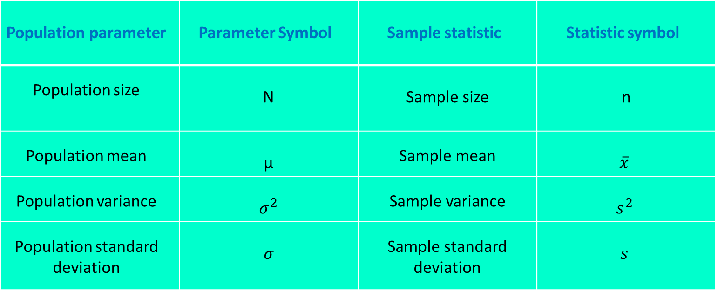
Hypothesis Testing
We use sample statistics to conduct hypothesis tests about population parameters.
Population parameter | Parameter Symbol | Sample statistic | Statistic symbol
Population size | N | Sample size | n
Population mean | µ | Sample mean | $$\overline{x}$$
Population variance | $$σ^{2}$$ | Sample variance | $$s^{2}$$
Population standard deviation | $$σ$$ | Sample standard deviation | $$s$$

Slide 7
Hypothesis Testing
Consider the market for Product A. Suppose, last year, the average quantity demanded for Product A was 500,000 units. At the beginning of this year the producers of Product A launched an advertising campaign and are interested to measure if mean quantity demanded for Product A has increased this year.
We cannot collect information on all consumers in the population. So we extract a random sample of consumers and use information from that sample to test the hypothesis whether population mean has increased due to advertising.

Slide 8
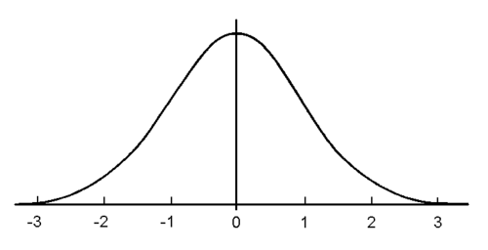
Standard Normal Distribution
Suppose that final exam grades for a particular course is normally distributed. If grades are normal standardized, then the mean of the standard normal variable is 0, and the standard deviation is equal to 1.

Slide 9
Standard Normal Distribution
Normal distribution is asymptotic along the horizontal axis.
The distribution is symmetric along the center
The total area under the curve is equal to 1. Therefore, by symmetry, area to the left of 0 (center) is 0.5 and area to the right of 0 is 0.5.
The standardized values, z, are on the horizontal axis. They are called critical values.

